Slide 1

BUDGET MANAGEMENT TRAINING
Scott McElroy
scottmcelroy@clayton.edu
(678) 466-4285

Slide 2
AGENDA
Sources of funds
Different budgets
Summary budget reports
Quarterly reviews and reports
Budget amendments

Slide 3
SOURCES OF FUNDS
The University System of Georgia (USG) operates through a Fund Accounting approach. This means that
our funds are not just in one lump sum, but instead the funds are categorized depending on the source
of funds. Below are the different sources of funds within the USG:
10000 – State Appropriation
10500 – Tuition
10600 – Other General Funds
12210 – Housing
12220 – Food Services
12230 – Stores & Shops
12240 – Health Services
12250 – Parking & Transportation
12270 – Other Auxiliary Enterprises
12280 – Athletics
13000 – Student Activities
14000 – Continuing Education
14100 – Other Departmental Sales & Services
15000 – Indirect Cost Recoveries
16000 – Technology Fees
20000 – Sponsored Operations
50000 – Capital Outlay

Slide 4
EXPENDITURE BUDGETS
All departments on campus that have an expenditure budget will have the following chart string breakdown: FUND; DEPT ID; PROGRAM; CLASS. There is a listing of all departmental accounts and associated chart strings at the following link: http://www.clayton.edu/budget/accounts. You need to be sure that you include the correct chart string associated with your department for any documents that you send to the Budget & Finance division for processing e.g. check request, purchase order, expense reports.
The budgets for expenditures are broken down into 2 separate categories: Appropriation and
Organization. The department’s overall budget falls into the Appropriation category. There are 4
different categories within the Appropriation level:
500000 – Personal Services
600000 – Travel
700000 – Operating Supplies & Expenses
800000 – Equipment/Capital Outlay

Slide 5
EXPENDITURE BUDGETS
The only category that has funds budgeted at the Organization level is Personal Services. Below are the
Organization categories for Personal Services:
511000 – Regular Faculty
512000 – Part-Time Faculty
513000 – Summer Faculty
514000 – Salaries – Faculty Overload
516000 – Salaries – Other – Faculty
521000 – Professional & Administrative
522000 – Staff
523000 – Graduate Assistants
524000 – Student Assistants
525000 – Casual Labor
526000 – Salaries – Other – Staff
527000 – President Allowance
551000 – FICA/FICA Medicare Benefits
552000 – Retirement
553000 – Group Insurance
561000 – Employee Awards

Slide 6
REVENUE BUDGETS
If your department generates revenue, you can find the correct chart string associated with that revenue account at the following link: https://clayton.edu/budget/accounts. The departmental budgets that are directly related to revenue are established at the beginning of the year based on an estimate of how much we anticipate collecting. These estimates are provided to the Budget Office either by the fee manager or in the case of some fees such as course fees and application fees these are provided by the Provost Office. The original budget is created using these estimates. The Budget Office performs a revenue analysis on a quarterly basis to determine if any of these revenue accounts have exceeded their estimate. The Budget Office will contact those departments and let them know that a budget amendment will occur to reflect the new budget. However, if at any time during the fiscal year you notice that your revenue collected has exceeded the estimate, you can contact the Budget Office. The Budget Office will then amend the budget to reflect the actual amount of revenue collected.
Departments that have budgets directly related to revenue must operate differently than the other departments that are allocated a certain amount from the University. These revenue related departments can only spend up to the amount that you collect. Even if the budget amount indicates that you still have funds remaining in your account, you cannot use those funds until you collect the funds to cover it.
In order to perform an analysis of the amount you still have available to spend, you can run a Ledger History Report with instructions and screen prints located at the following link: https://clayton.edu/budget/budget-managers. This report compares revenue collected and funds spent to provide you with the balance of funds you have available.

Slide 7
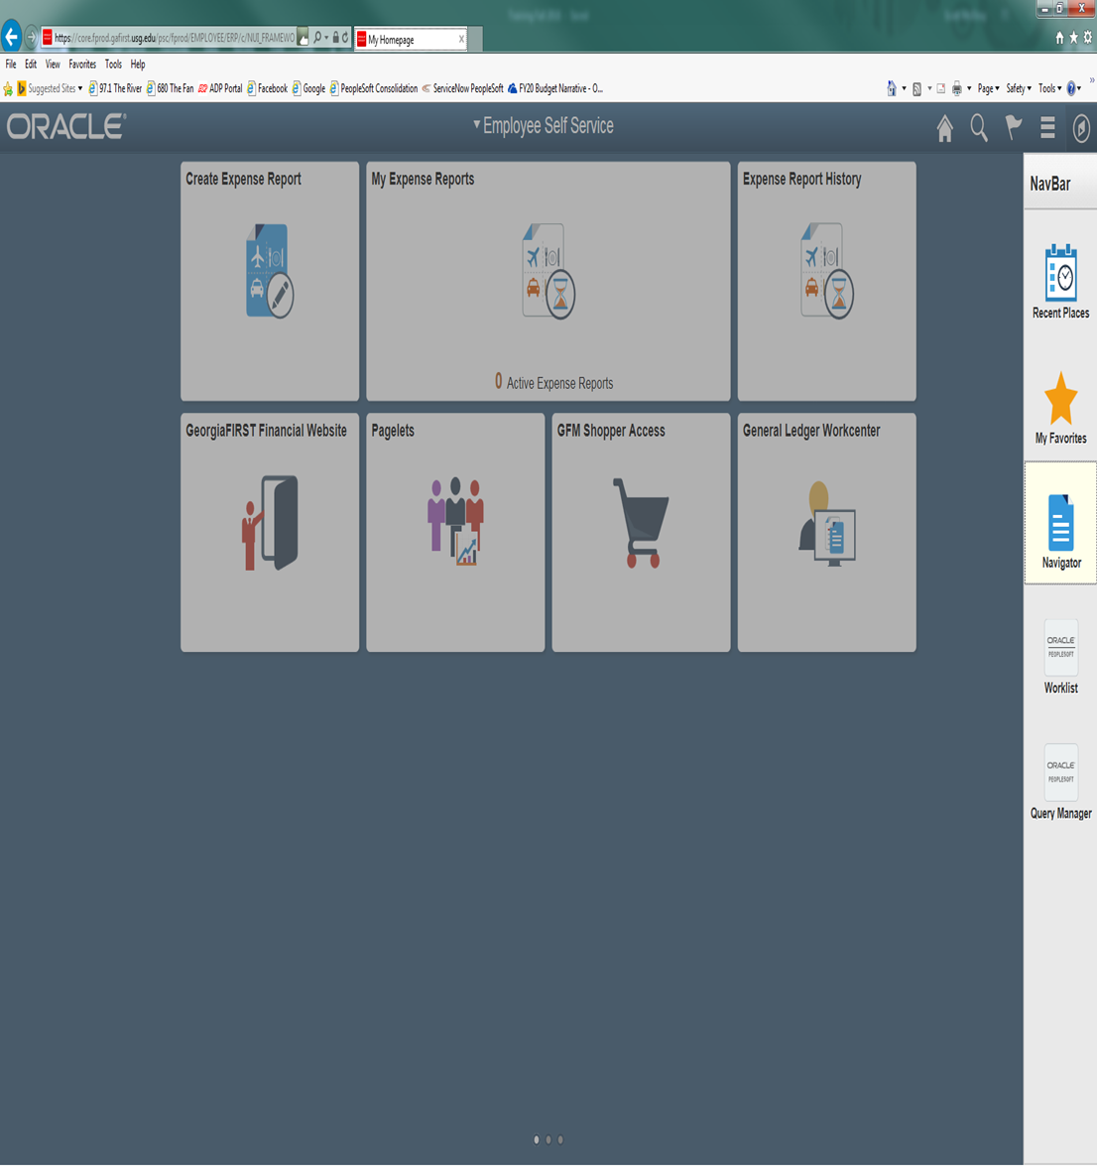
BUDGET STATUS- APPROP (APPROPRIATION) STATUS
The following screen shots will show you how to access the Budget Status Report for APPROP summary. This report will give you a quick look at the summary of your budget based on the Appropriation levels (500000-Personal Services; 600000-Travel; 700000-OS&E; 800000-Equipment).
You will need to click on icon in the far upper right-hand corner of the panel which looks like a ‘diamond inside a circle’. This will bring up your NavBar. Once you have the NavBar pulled up, you will click on the Navigator link.

Slide 8
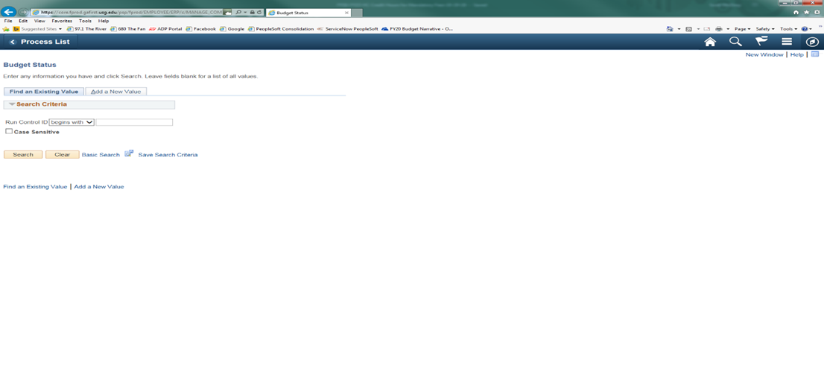
COMMITMENT CONTROL>BUDGET REPORTS>BUDGET STATUS

Slide 9
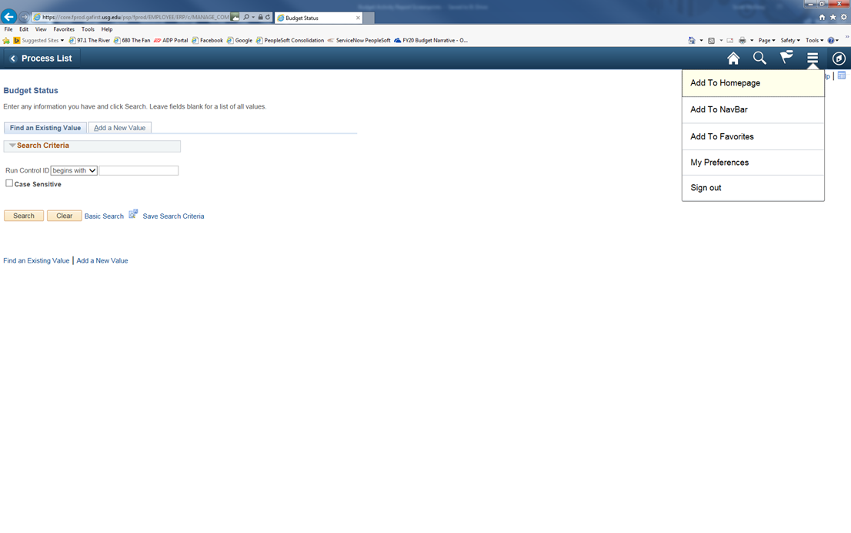
At this time, you can save this process as a favorite for future reference. You just need to click on the icon that has 3 lines in the upper right-hand corner which has a drop-down menu. You will click on Add to Favorites link at the top and enter a description before clicking OK.

Slide 10
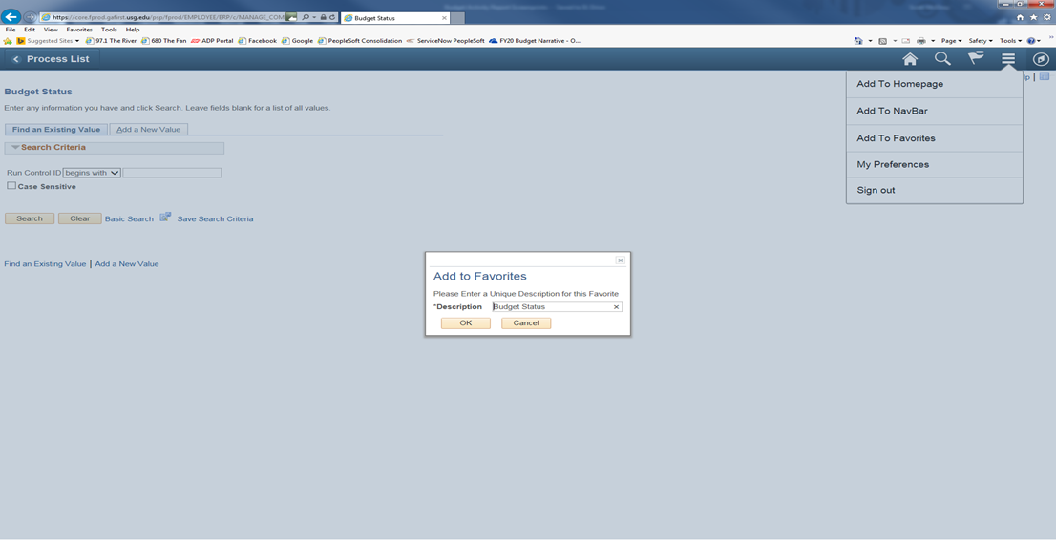
Click on the tab for Add a New Value. You can enter a Run Control ID that you will remember for this report such as Approp_Status then click the Add button.
Note: You can’t have any spaces, so you must use underscore in place of any space you wish.

Slide 11
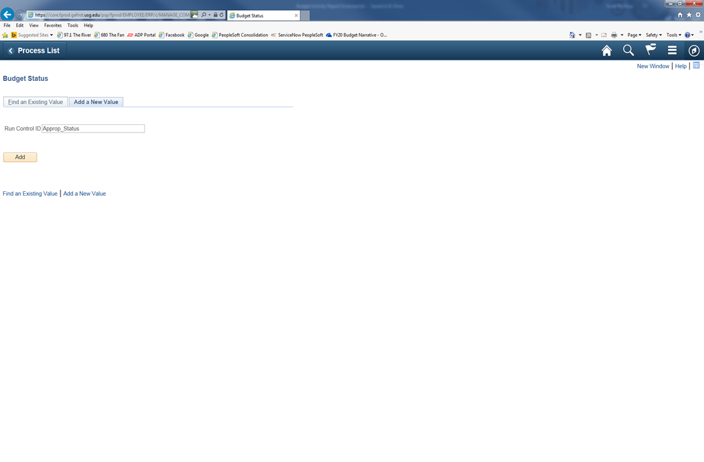

Slide 12
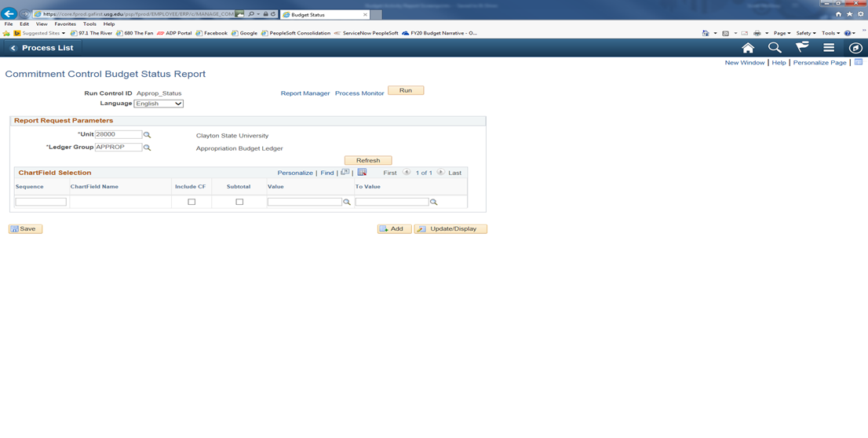
Be sure to indicate the APPROP Ledger Group, by clicking on the magnifying glass next to the Ledger Group box, then click on the Refresh button.

Slide 13
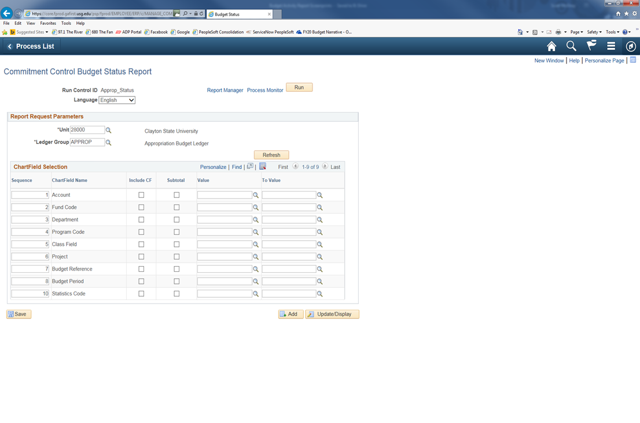

Slide 14

To set up your report, reorder the Sequence as follows: 1-Fund Code; 2-Department; 3-Program Code; 4-Class; 5-Account; 6-Budget Reference.
After you reorder the Sequence, be sure to click on the Include CF button for each of these categories. Enter the numbers for your department in the Value and To Value fields at this point. You also will need to enter the numbers of the fiscal year in the Value and To Value fields at this point. Once you have input all the numbers for your department, you can click on the Save button and the correct sequence order will be shown. Then click on the Run button at the top to initiate the process.

Slide 15
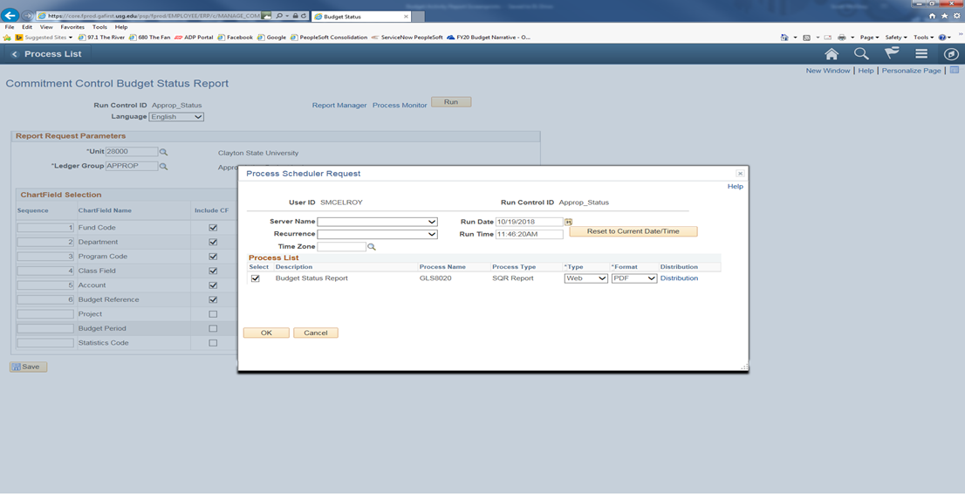
When the Process Scheduler Request screen appears, click on OK to schedule the process.

Slide 16
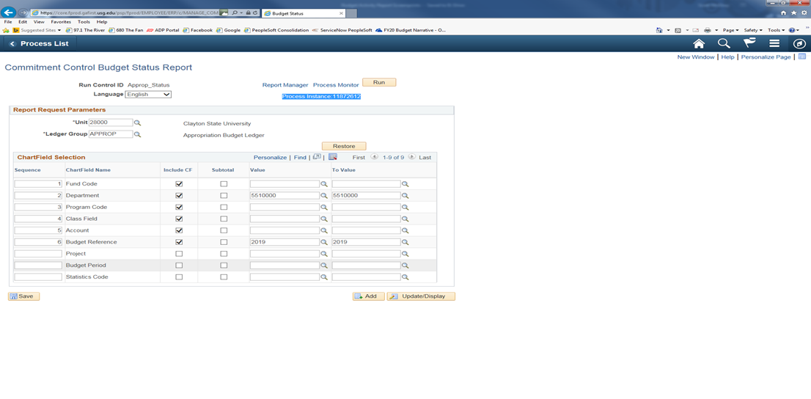
After clicking on OK, it will take you back to the report format screen. You will notice a Process Instance number just under the Run button at the top of the page. You need to make a note of this Process Instance number that will be used in the next section of the process. At this time, you will click on the Process Monitor link.

Slide 17
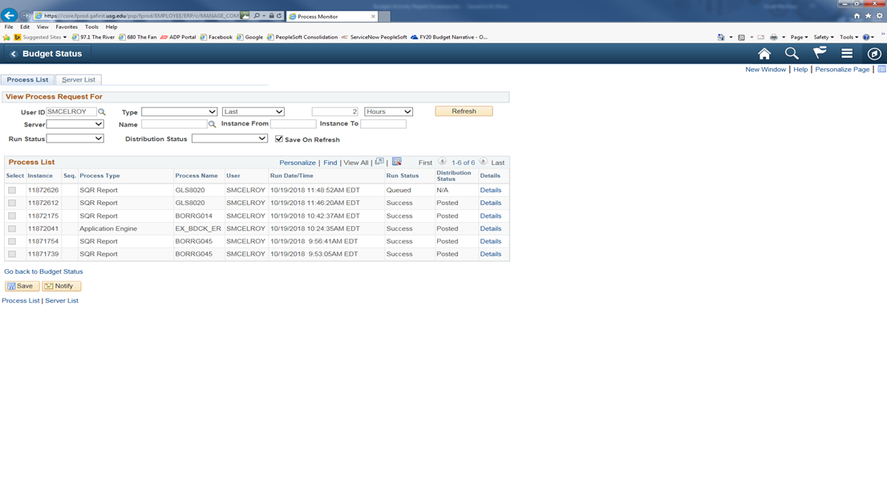
If, at this time the Run Status on your Process Instance doesn’t show as Success or Distribution Status doesn’t show as Posted, you will need to click on the Refresh button at the top until it reaches this status.

Slide 18
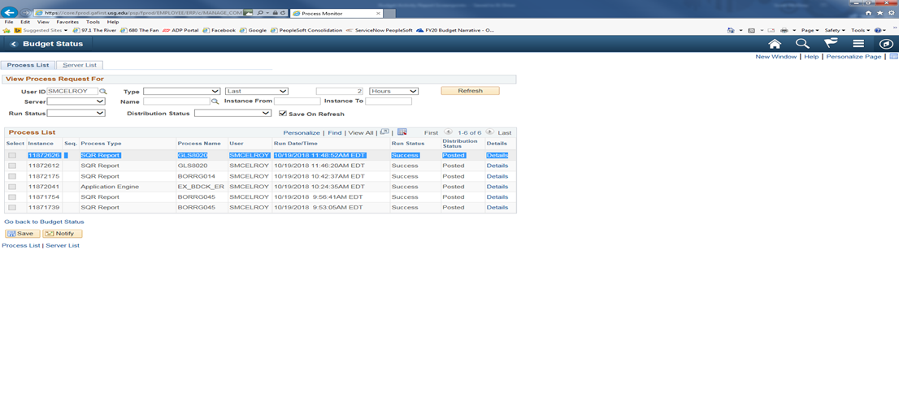

Slide 19
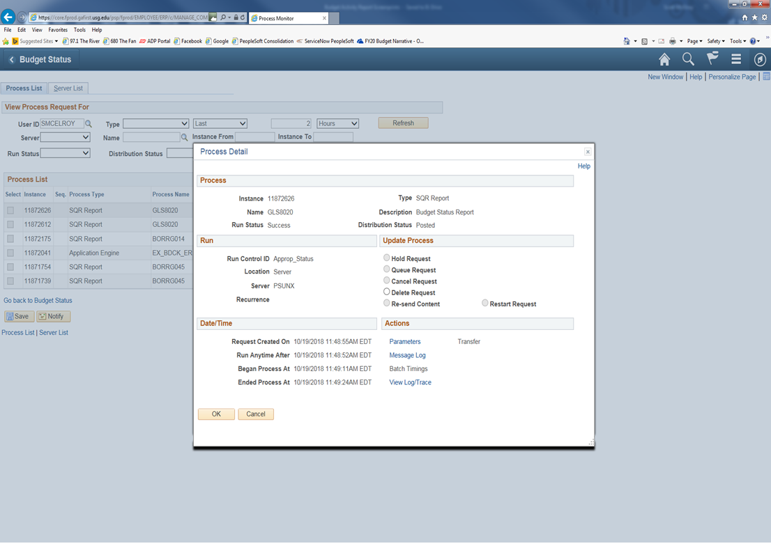
To access the report that you just ran, you will need to click on the Details link in the line for your Process Instance number.

Slide 20
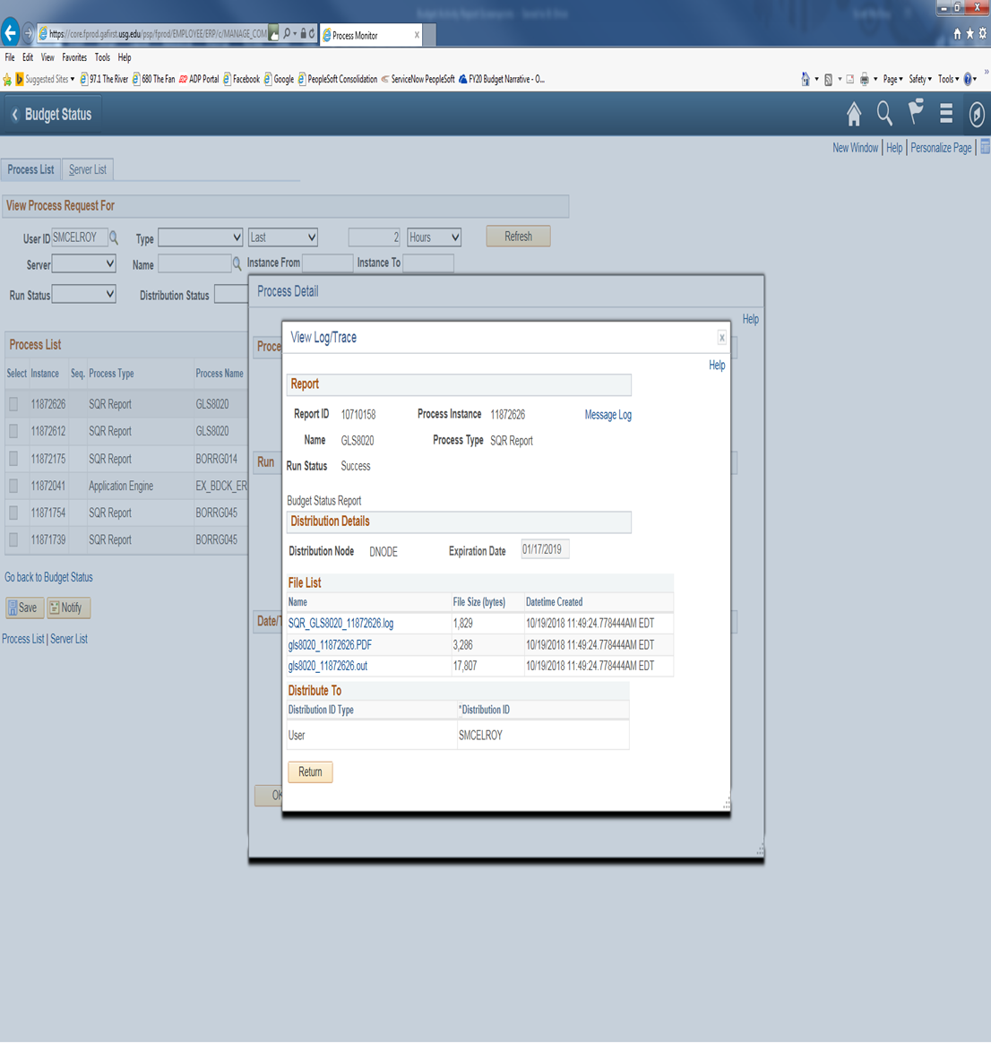
Then from the Process Detail screen, you will click on the link View Log/Trace.

Slide 21
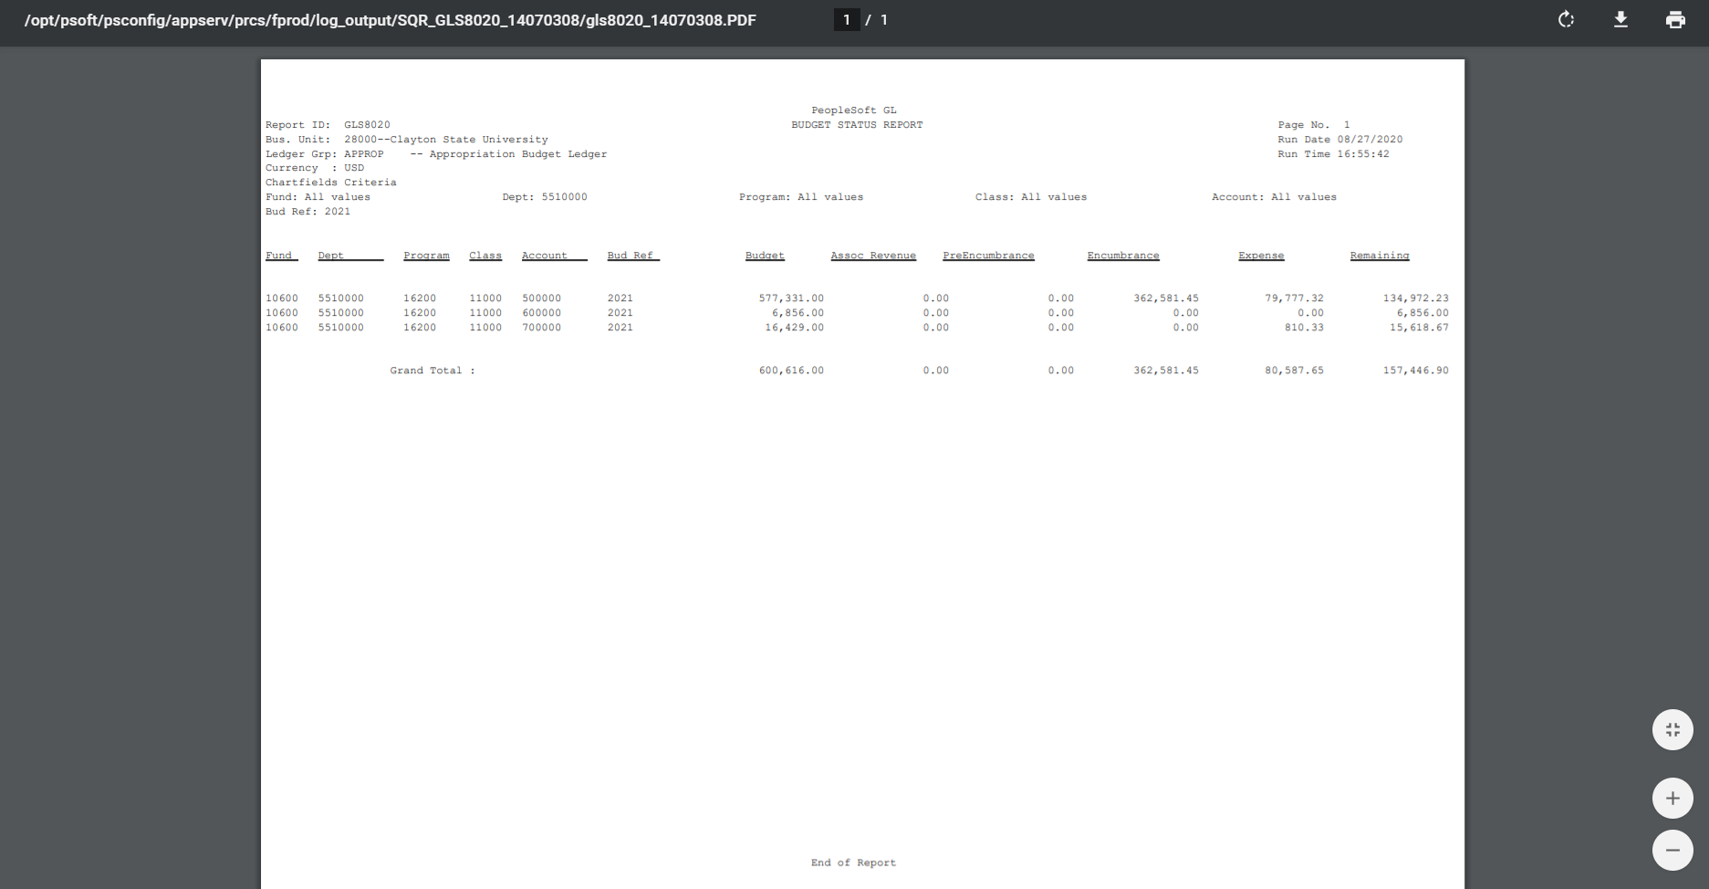
From the View Log/Trace screen, you will click on the link for the PDF file in the File List. This will bring up the Budget Status Report that you just ran. You can then either Download or Print the report.

Slide 22

BUDGET STATUS- ORG (ORGANIZATION) STATUS
The following screen shots will show you how to access the Budget Status Report for ORG summary. This report will give you a quick look at the summary of your Personal Services budget based on the Organization levels (511000-Regular Faculty; 512000-PT Faculty; 513000-Summer Faculty; 514000-Faculty Overload; 516000-Salaries-Other-Faculty; 521000-Professional/Admin; 522000-Staff; 523000-Graduate Assistant; 524000-Student Assistant; 525000-Casual Labor; 526000-Salaries-Other-Staff; 527000-President Allowance; 551000-FICA; 552000-Retirement; 553000-Group Insurance).
You will need to click on icon in the far upper right-hand corner of the panel which looks like a ‘diamond inside a circle’. This will bring up your NavBar. Once you have the NavBar pulled up, you will click on the Navigator link.

Slide 23
COMMITMENT CONTROL>BUDGET REPORTS>BUDGET STATUS

Slide 24
At this time, you can save this process as a favorite for future reference. You just need to click on the icon that has 3 lines in the upper right-hand corner which has a drop-down menu. You will click on Add to Favorites link at the top and enter a description before clicking OK.

Slide 25
Click on the tab for Add a New Value. You can enter a Run Control ID that you will remember for this report such as Org_Status then click the Add button.
Note: You can’t have any spaces, so you must use underscore in place of any space you wish.

Slide 26


Slide 27
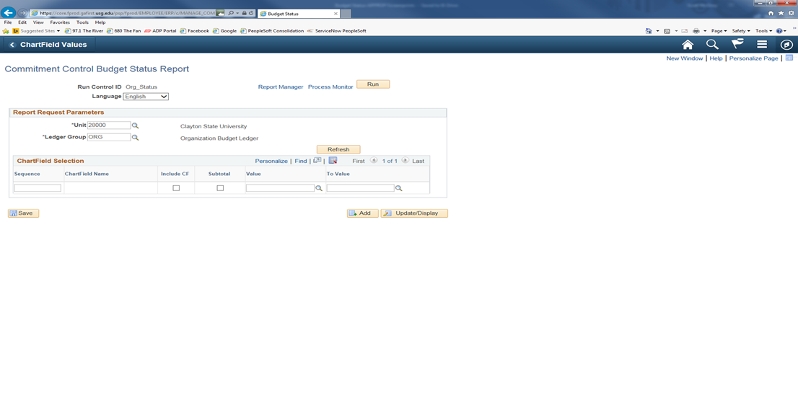
Be sure to indicate the ORG Ledger Group, by clicking on the magnifying glass next to the Ledger Group box, then click on the Refresh button.

Slide 28


Slide 29
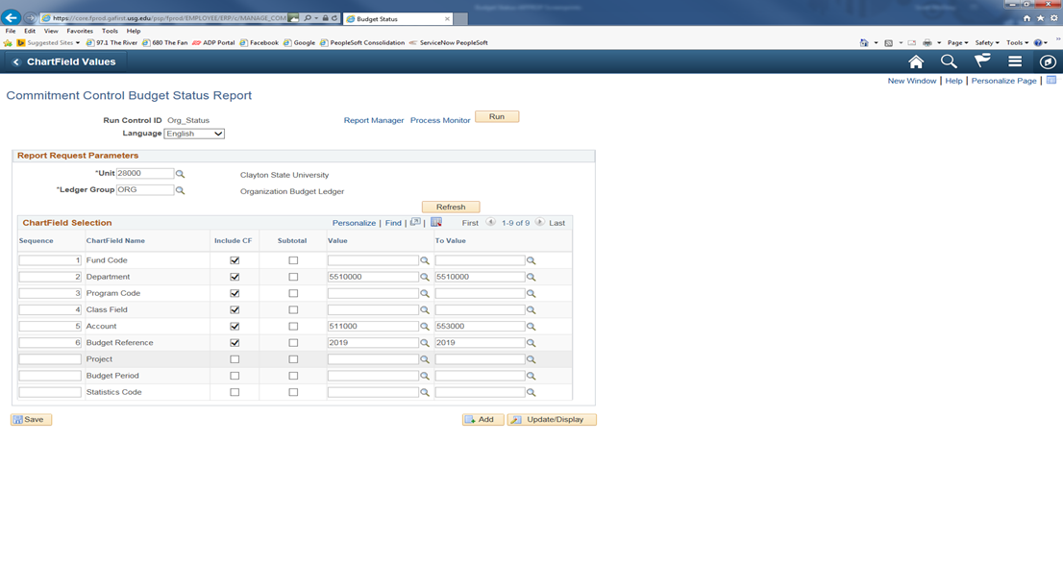
To set up your report, reorder the Sequence as follows: 1-Fund Code; 2-Department; 3-Program Code; 4-Class; 5-Account; 6-Budget Reference.
After you reorder the Sequence, be sure to click on the Include CF button for each of these categories. Enter the numbers for your department in the Value and To Value fields at this point. You also will enter these numbers in the Value 511000 and To Value 553000 to get all the Personal Services for your department. You also will need to enter the numbers of the fiscal year in the Value and To Value fields at this point. Once you have input all the numbers for your department, you can click on the Save button and the correct sequence order will be shown. Then click on the Run button at the top to initiate the process.

Slide 30

When the Process Scheduler Request screen appears, click on OK to schedule the process.

Slide 31
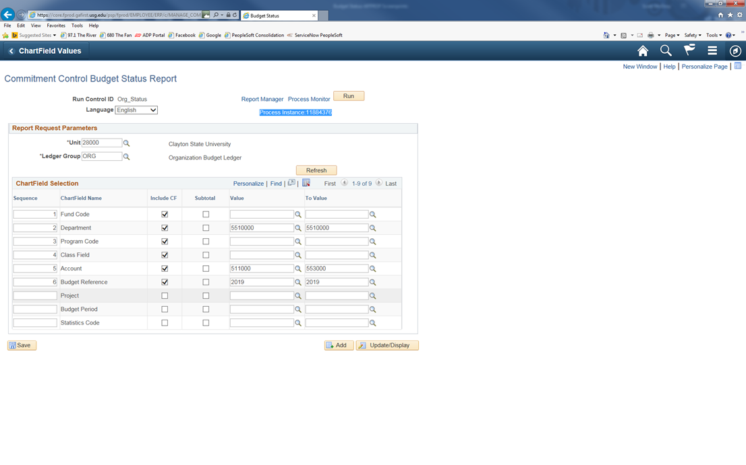
After clicking on OK, it will take you back to the report format screen. You will notice a Process Instance number just under the Run button at the top of the page. You need to make a note of this Process Instance number that will be used in the next section of the process. At this time, you will click on the Process Monitor link.

Slide 32
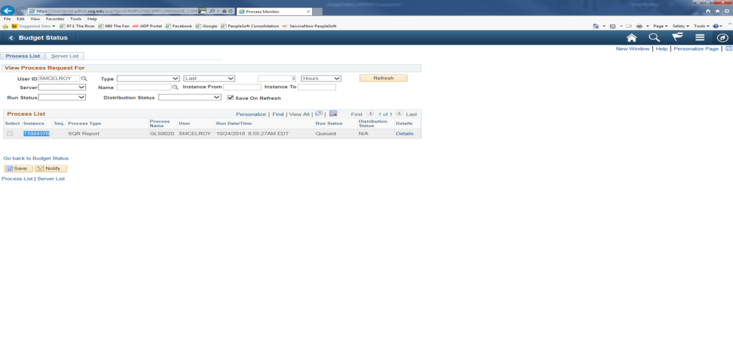
If, at this time the Run Status on your Process Instance doesn’t show as Success or Distribution Status doesn’t show as Posted, you will need to click on the Refresh button at the top until it reaches this status.

Slide 33
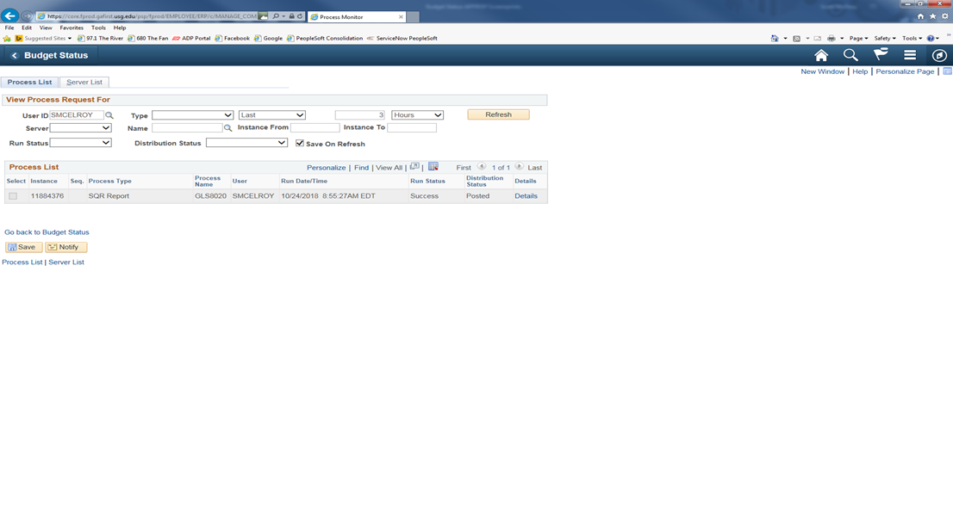

Slide 34
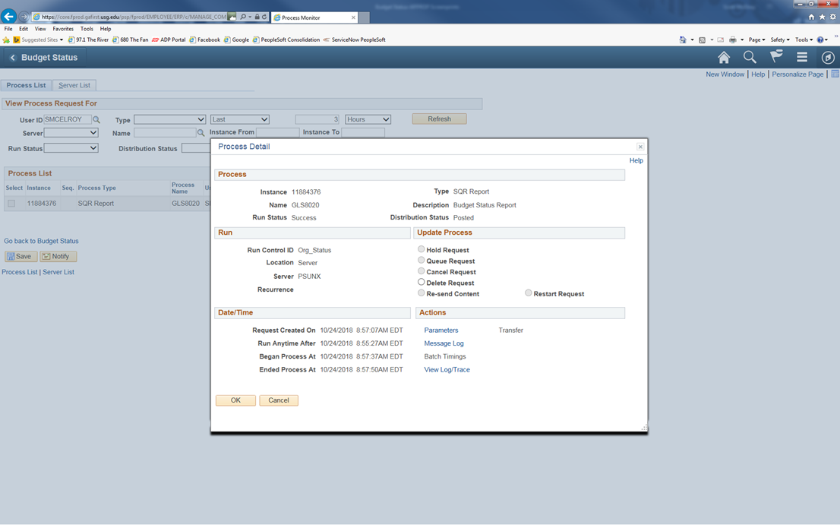
To access the report that you just ran, you will need to click on the Details link in the line for your Process Instance number.

Slide 35
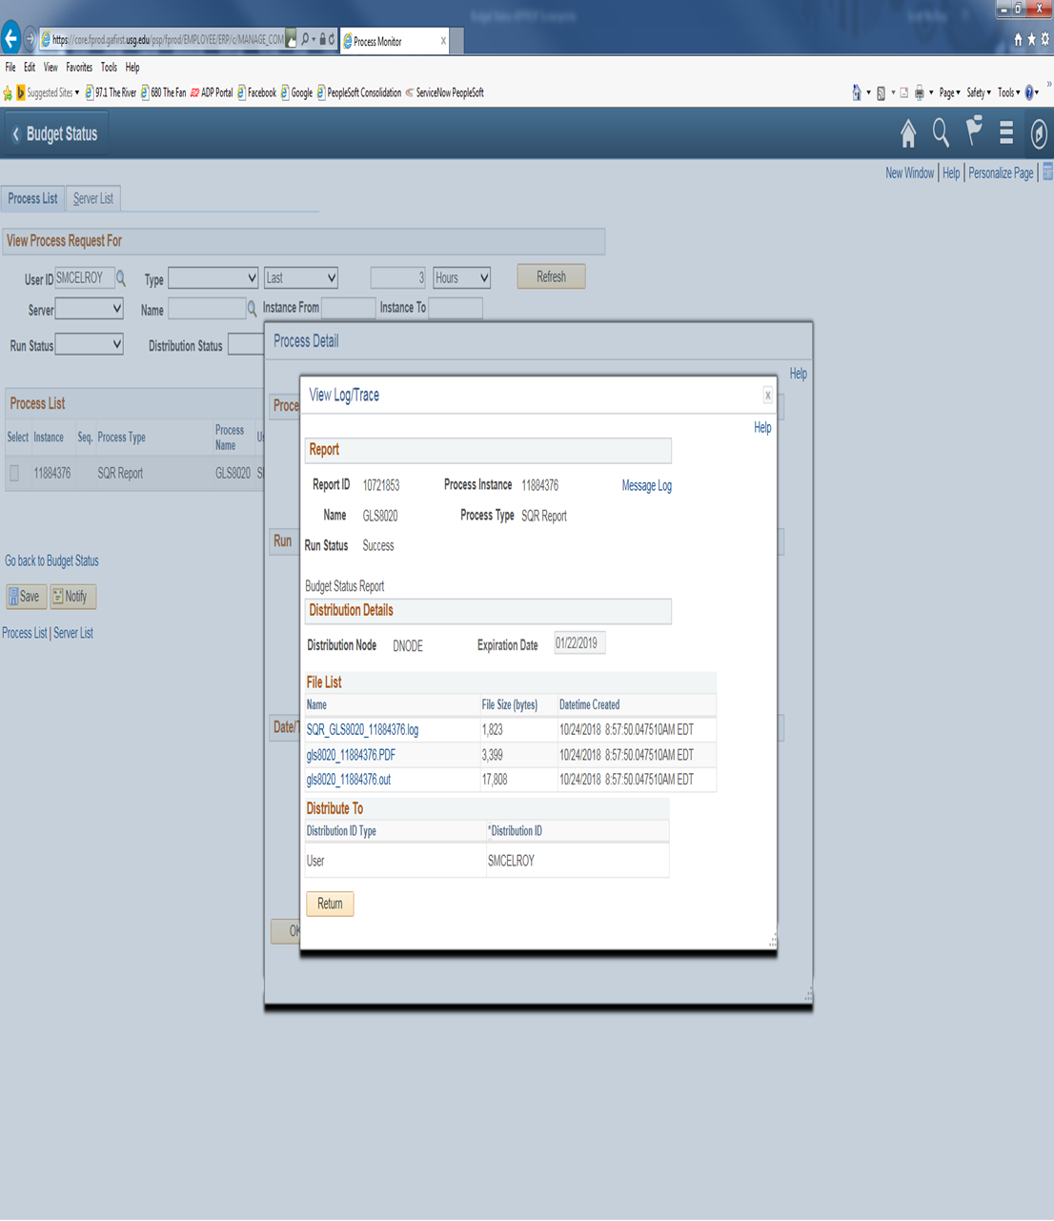
Then from the Process Detail screen, you will click on the link View Log/Trace..

Slide 36
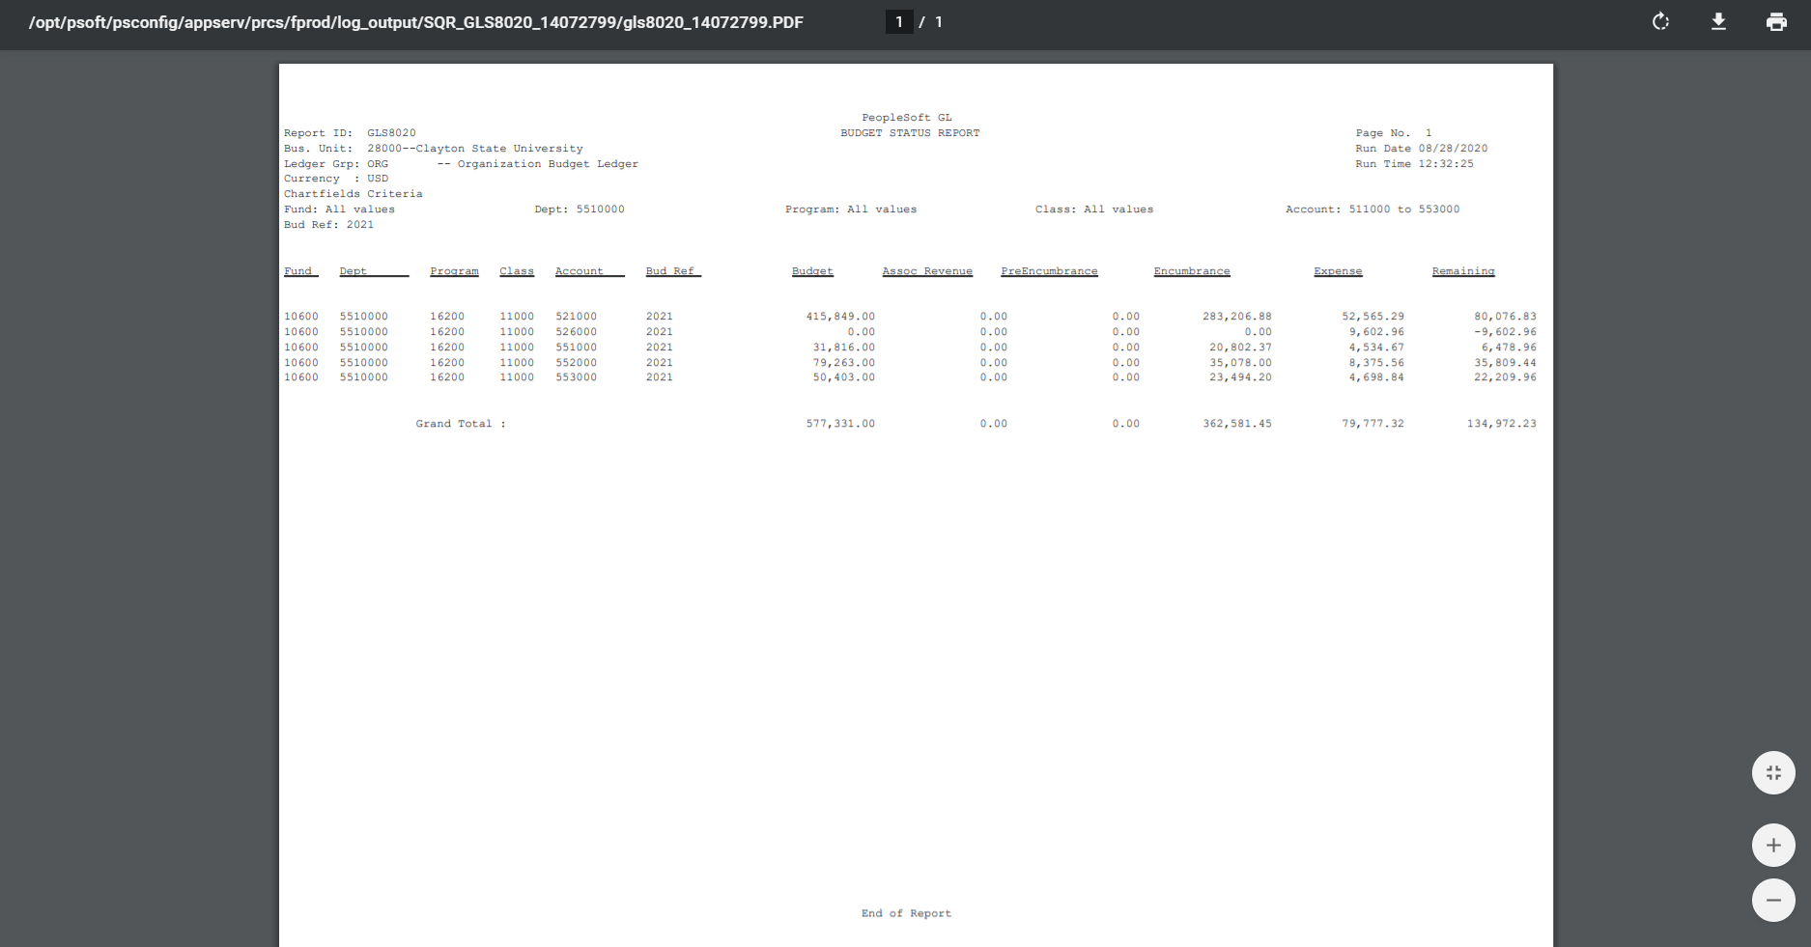
From the View Log/Trace screen, you will click on the link for the PDF file in the File List. This will bring up the Budget Status Report that you just ran. You can then either Save As or Print the report.

Slide 37

BUDGET STATUS- REVEST (REVENUE) STATUS
The following screen shots will show you how to access the Budget Status for REVEST summary. This report will show you a quick summary look at the departmental revenue collected at the budgetary level.
You will need to click on icon in the far upper right-hand corner of the panel which looks like a ‘diamond inside a circle’. This will bring up your NavBar. Once you have the NavBar pulled up, you will click on the Navigator link.

Slide 38
COMMITMENT CONTROL>BUDGET REPORTS>BUDGET STATUS

Slide 39
At this time, you can save this process as a favorite for future reference. You just need to click on the icon that has 3 lines in the upper right-hand corner which has a drop-down menu. You will click on Add to Favorites link at the top and enter a description before clicking OK.

Slide 40
Click on the tab for Add a New Value. You can enter a Run Control ID that you will remember for this report such as Revenue_Status then click the Add button.
Note: You can’t have any spaces, so you must use underscore in place of any space you wish.

Slide 41


Slide 42
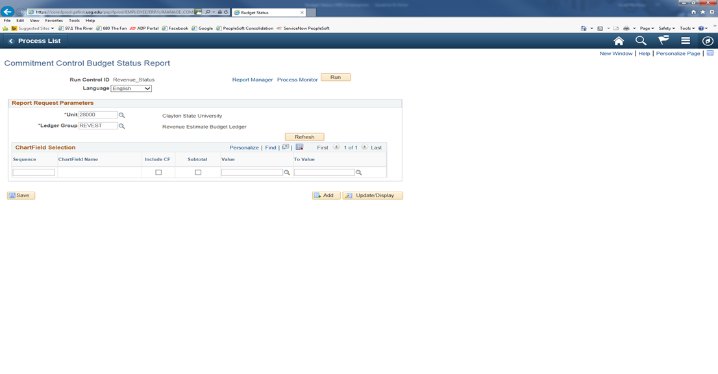
Be sure to indicate the REVEST Ledger Group, by clicking on the magnifying glass next to the Ledger Group box, then click on the Refresh button.

Slide 43


Slide 44

To set up your report, reorder the Sequence as follows: 1-Fund Code; 2-Department; 3-Program Code; 4-Class; 5-Account; 6-Budget Reference.
After you reorder the Sequence, be sure to click on the Include CF button for each of these categories. Enter the numbers for your department in the Value and To Value fields at this point. You also will need to enter the numbers of the fiscal year in the Value and To Value fields at this point. Once you have input all the numbers for your department, you can click on the Save button and the correct sequence order will be shown. Then click on the Run button at the top to initiate the process.

Slide 45

When the Process Scheduler Request screen appears, click on OK to schedule the process.

Slide 46

After clicking on OK, it will take you back to the report format screen. You will notice a Process Instance number just under the Run button at the top of the page. You need to make a note of this Process Instance number that will be used in the next section of the process. At this time, you will click on the Process Monitor link.

Slide 47
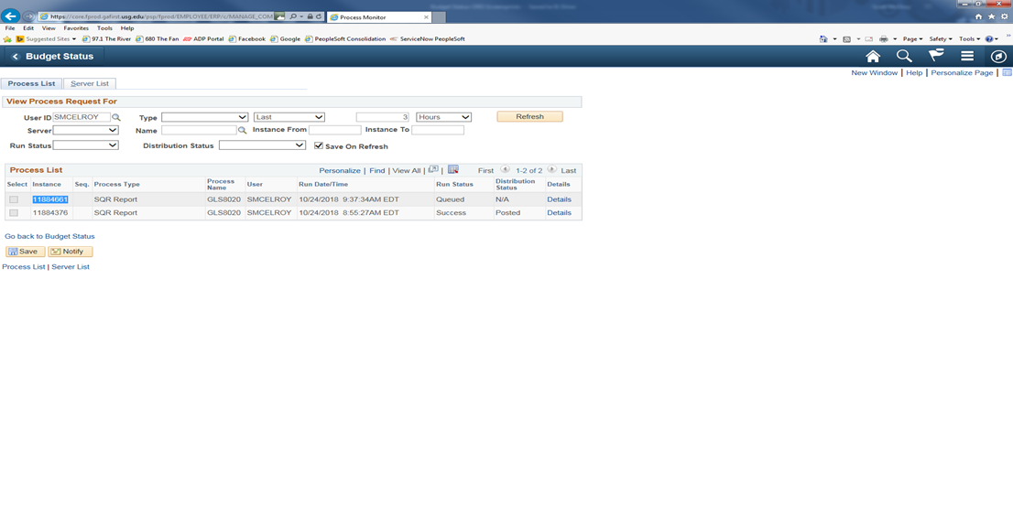
If, at this time the Run Status on your Process Instance doesn’t show as Success or Distribution Status doesn’t show as Posted, you will need to click on the Refresh button at the top until it reaches this status.

Slide 48
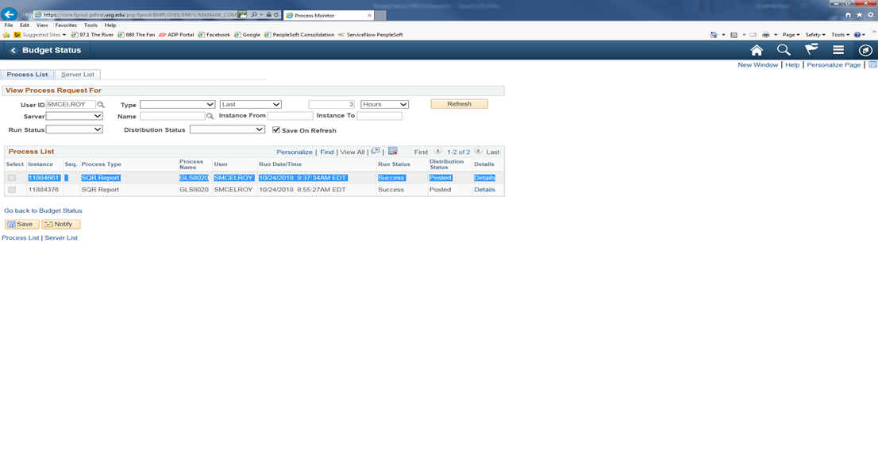

Slide 49

To access the report that you just ran, you will need to click on the Details link in the line for your Process Instance number.

Slide 50
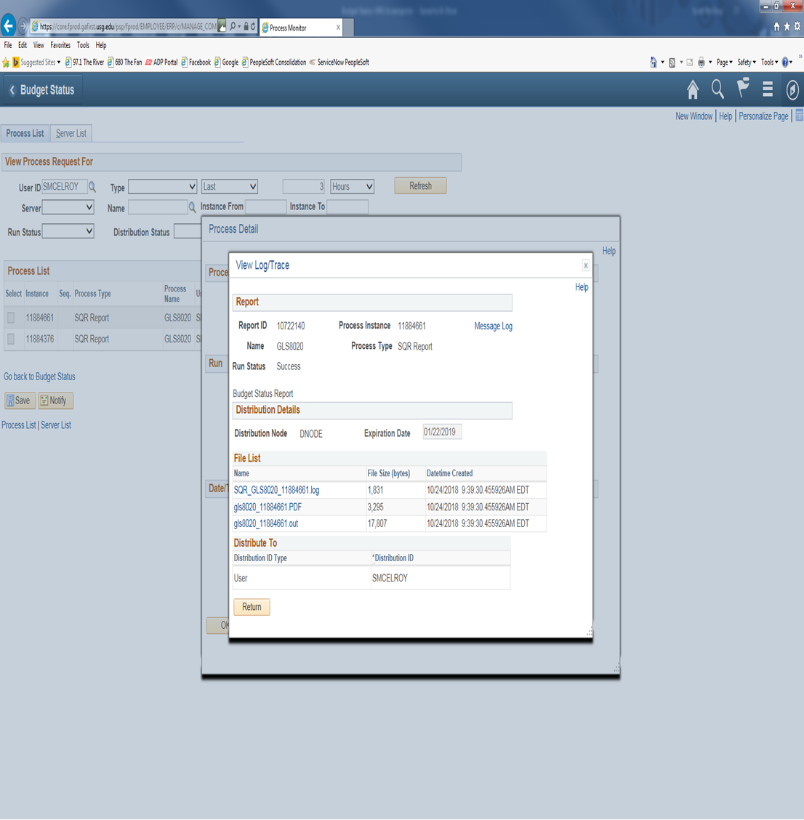
Then from the Process Detail screen, you will click on the link View Log/Trace.

Slide 51
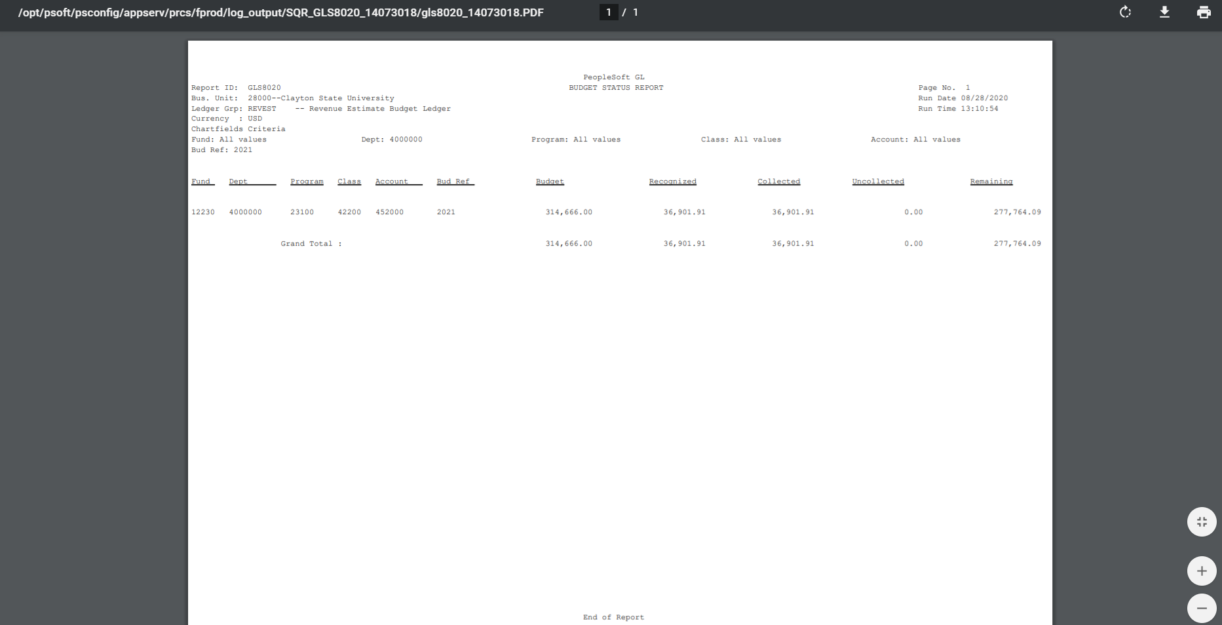
From the View Log/Trace screen, you will click on the link for the PDF file in the File List. This will bring up the Budget Status Report that you just ran. You can then either Save As or Print the report.

Slide 52
QUARTERLY BUDGET REVIEWS
Quarterly Expenditure Budget Review
All Budget Managers are required to regularly review their budgets and submit a Quarterly Expenditure Budget Review to the Budget Office. The best way to accomplish this review is to run a Budget Activity Report for your department. There are 2 different versions of this report. I encourage you to run the Detail version to review each expense that has posted against your department. You will see a journal line for each expense in the categories of Travel; OS&E; and Equipment. As far as your Personal Services expenses, it will only show a total for each pay period as a journal line. To find out the employees that make up that total, you will need to contact the Budget Office to run the query for your department. This query shows the employees and amounts that were paid for each pay period during that quarter.
Quarterly Revenue Budget Review
All Budget Managers that have revenue associated with their department are required to submit a Quarterly Revenue Budget Review to the Budget Office. You will need to submit the Revenue Summary Report for the revenue account associated with your department. This report only shows the summary of revenue collected during the quarter. If you want to see the details of journal entries that make up the total, you would need to run a Ledger History Report which can be found at the following link: https://clayton.edu/budget/budget-managers.

Slide 53
BUDGET ACTIVITY REPORT
The following screen shots will show you how to access the Budget Activity Report. The Budget Activity Report will give you either a detailed version of your departmental budget or a summary version of your departmental budget depending on the amount of detail you wish to have at the time you run the report.
You will need to click on icon in the far upper right-hand corner of the panel which looks like a ‘diamond inside a circle’. This will bring up your NavBar. Once you have the NavBar pulled up, you will click on the Navigator link.

Slide 54

BOR MENUS>BOR GENERAL LEDGER>BOR GL REPORTS>BUDGET ACTIVITY REPORT

Slide 55
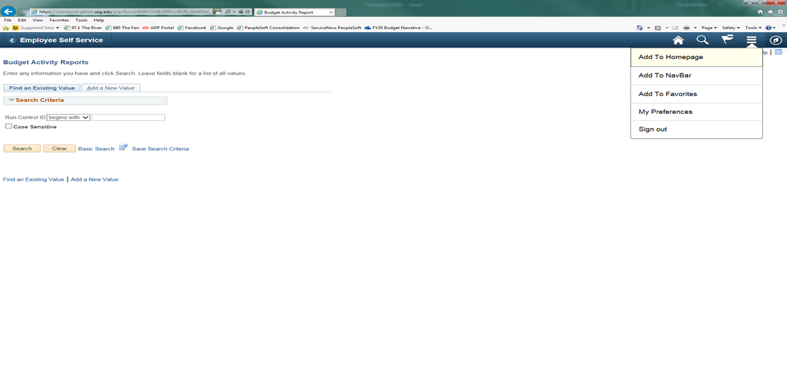
At this time, you can save this process as a favorite for future reference. You just need to click on the icon that has 3 lines in the upper right-hand corner which has a drop-down menu. You will click on Add to Favorites link at the top and enter a description before clicking OK.

Slide 56
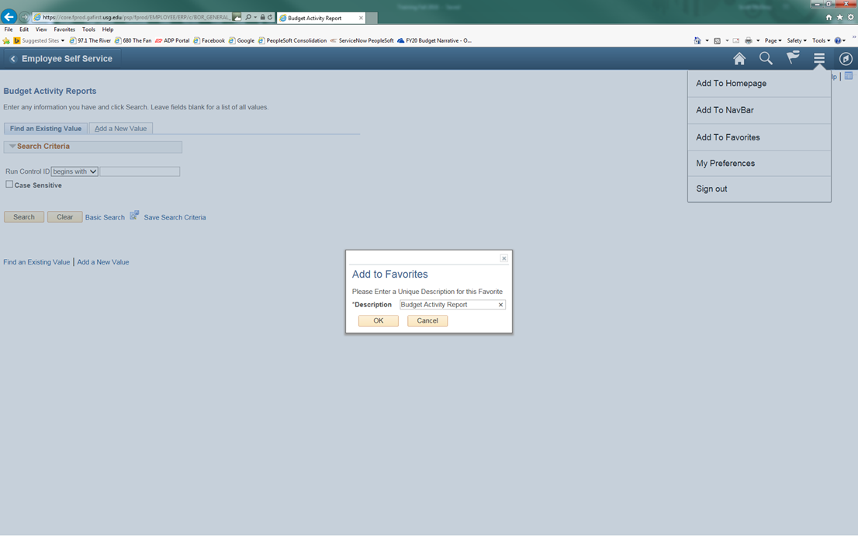
Click on the tab for Add a New Value. You can enter a Run Control ID that you will remember for this report such as Bud_Activity then click the Add button.
Note: You can’t have any spaces, so you must use underscore in place of any space you wish.

Slide 57
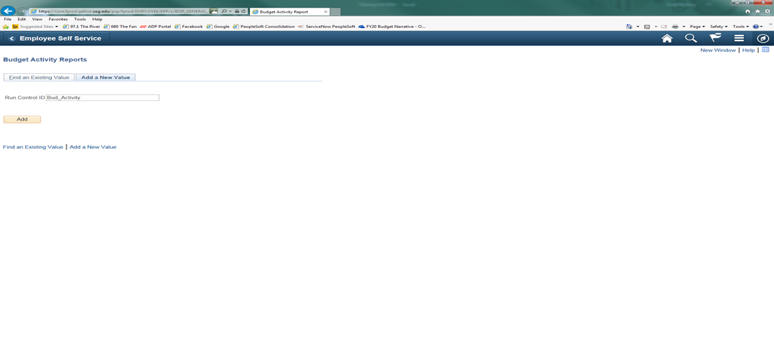

Slide 58
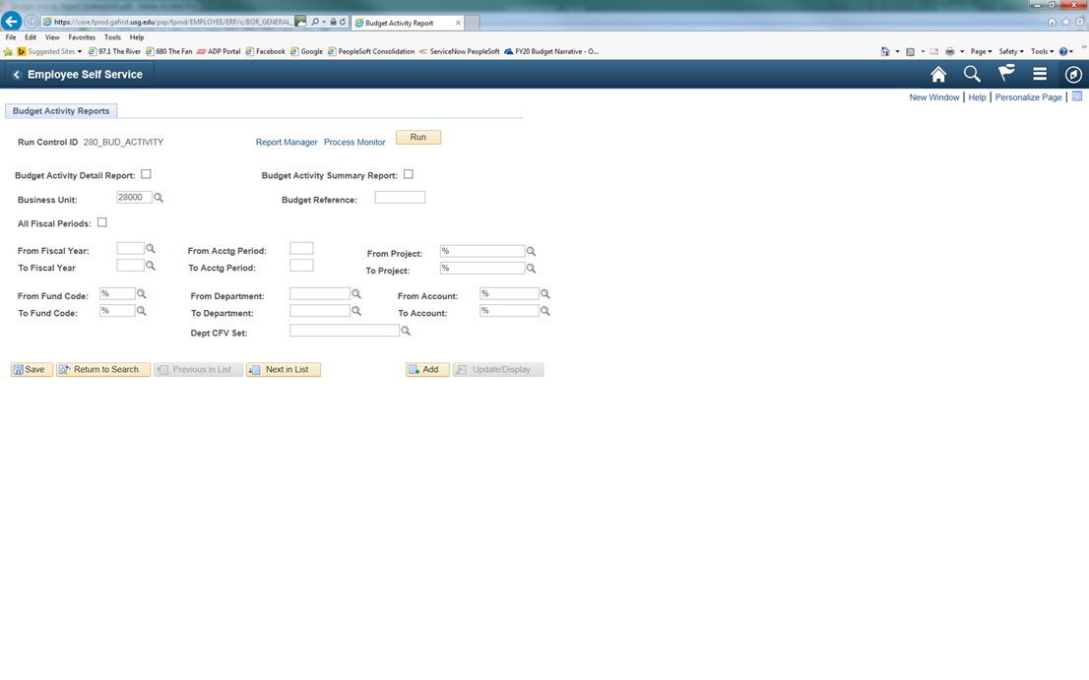

Slide 59
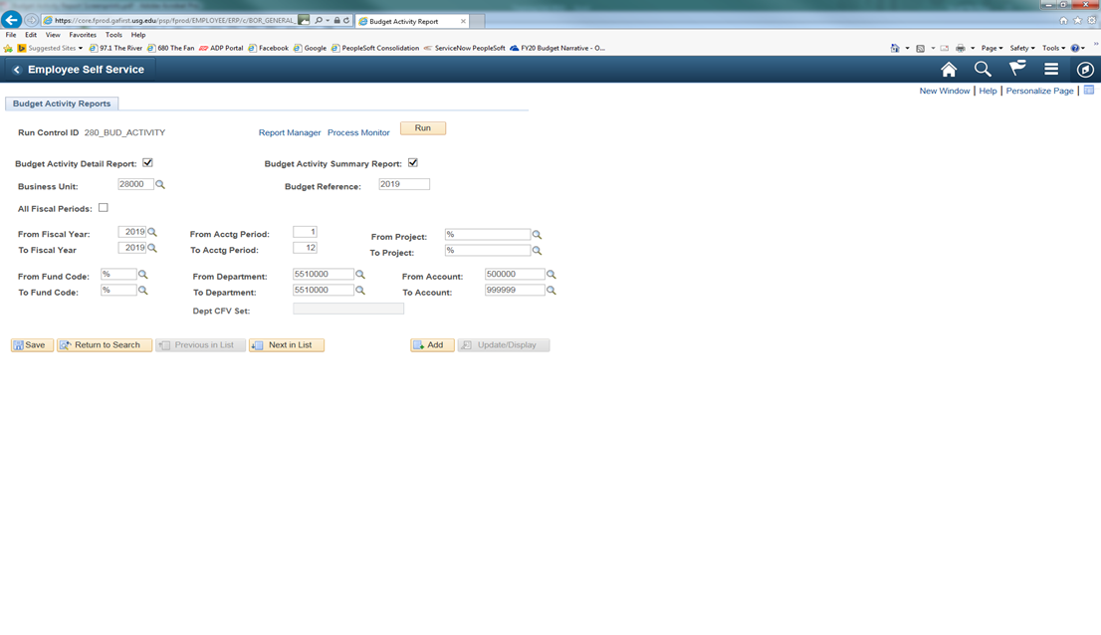
Once you have entered your departmental information, you can click on the Save button to save the parameters for the next time you access this report. Then you will need to click on the Run button at the top to initiate the process.

Slide 60
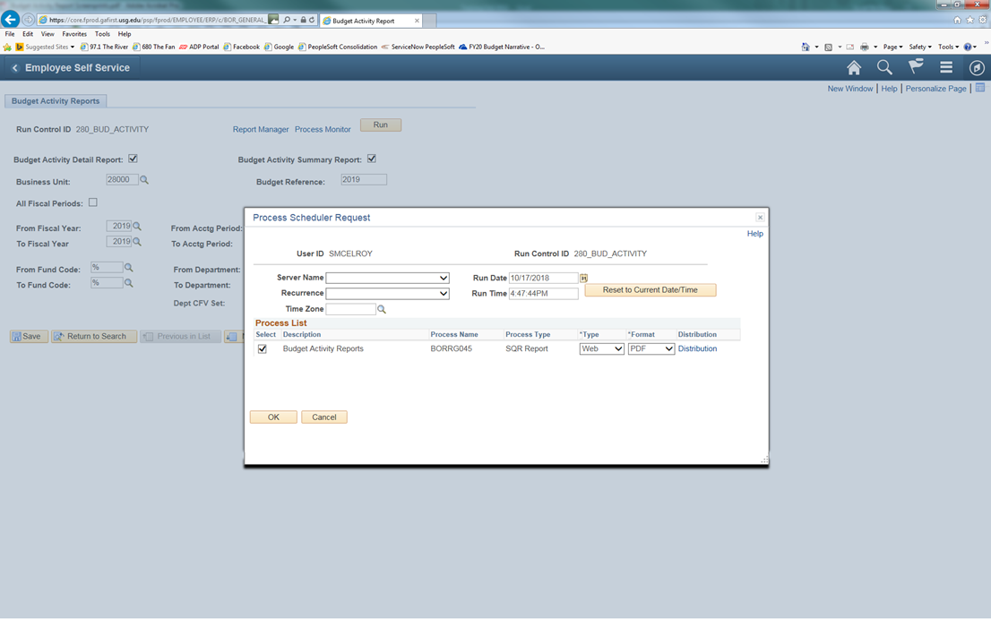
When the Process Scheduler Request screen appears, you only have the one option Budget Activity Reports which should already be preselected. You will just click OK to process the report.

Slide 61
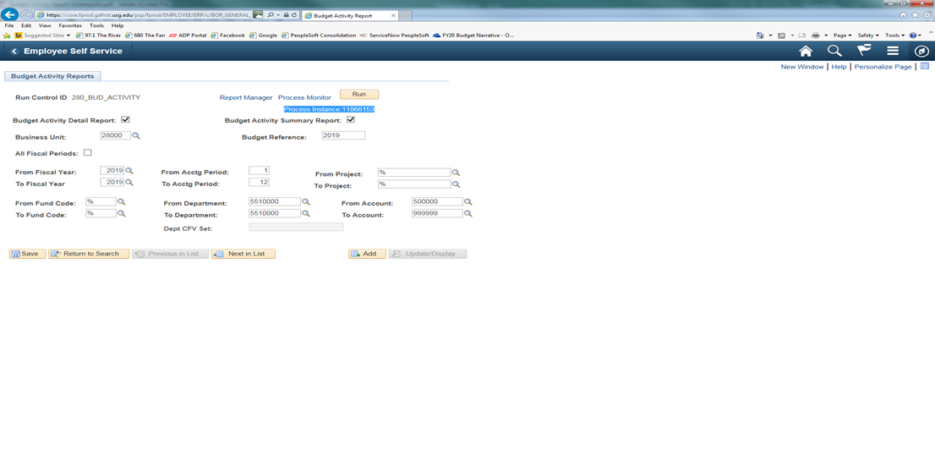
After clicking on OK, it will take you back to the report format screen. You will notice a Process Instance number just under the Run button at the top of the page. You need to make a note of this Process Instance number that will be used in the next section of the process. At this time, you will click on the Process Monitor link.

Slide 62
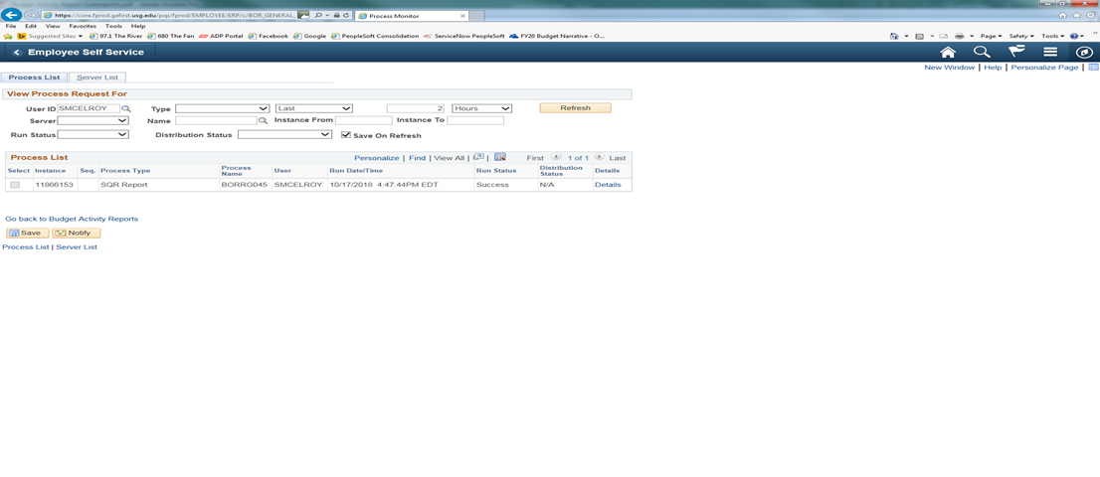
If, at this time the Run Status on your Process Instance doesn’t show as Success or Distribution Status doesn’t show as Posted, you will need to click on the Refresh button at the top until it reaches this status.

Slide 63


Slide 64
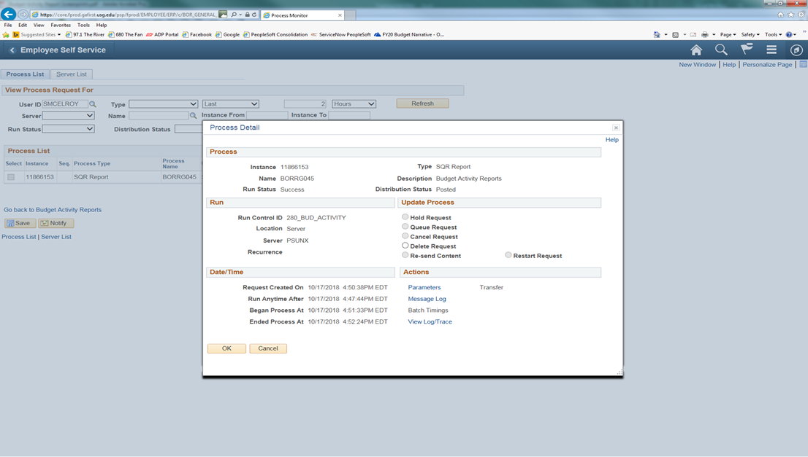
To access the report that you just ran, you will need to click on the Details link in the line for your Process Instance number.

Slide 65
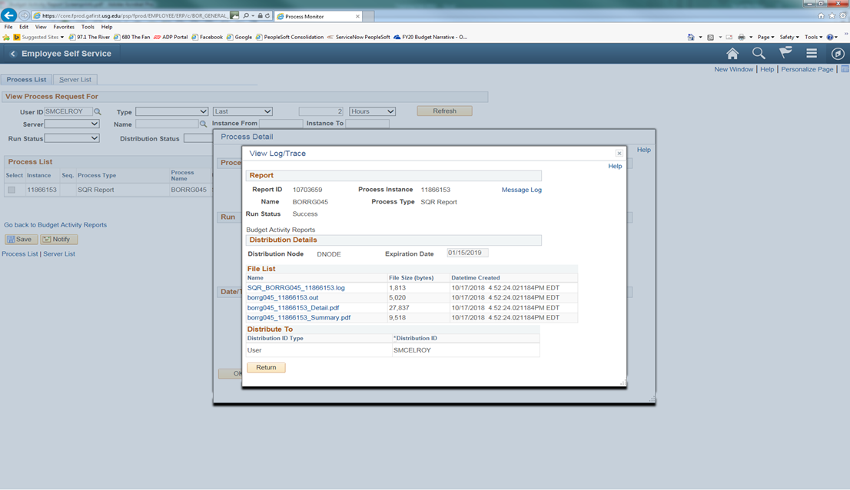
Then from the Process Detail screen, you will click on the link View Log/Trace.

Slide 66
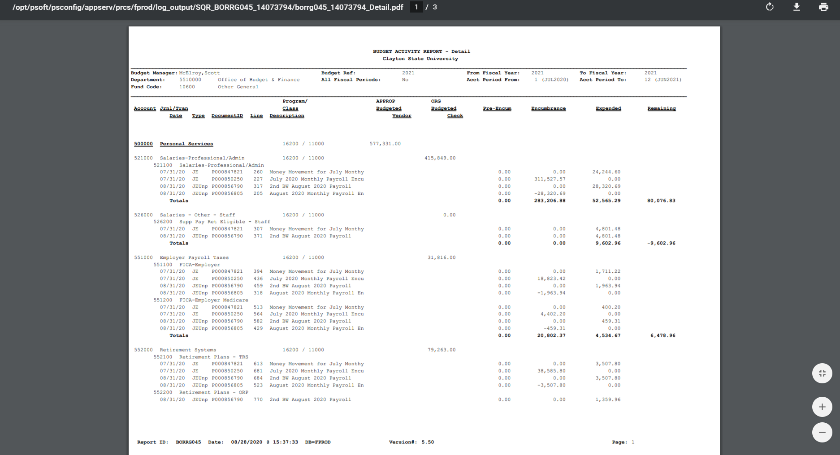
From the View Log/Trace screen, you will click on the link for the PDF file in the File List. This will bring up the Budget Activity Report that you just ran. You can then either Save As or Print the report.

Slide 67
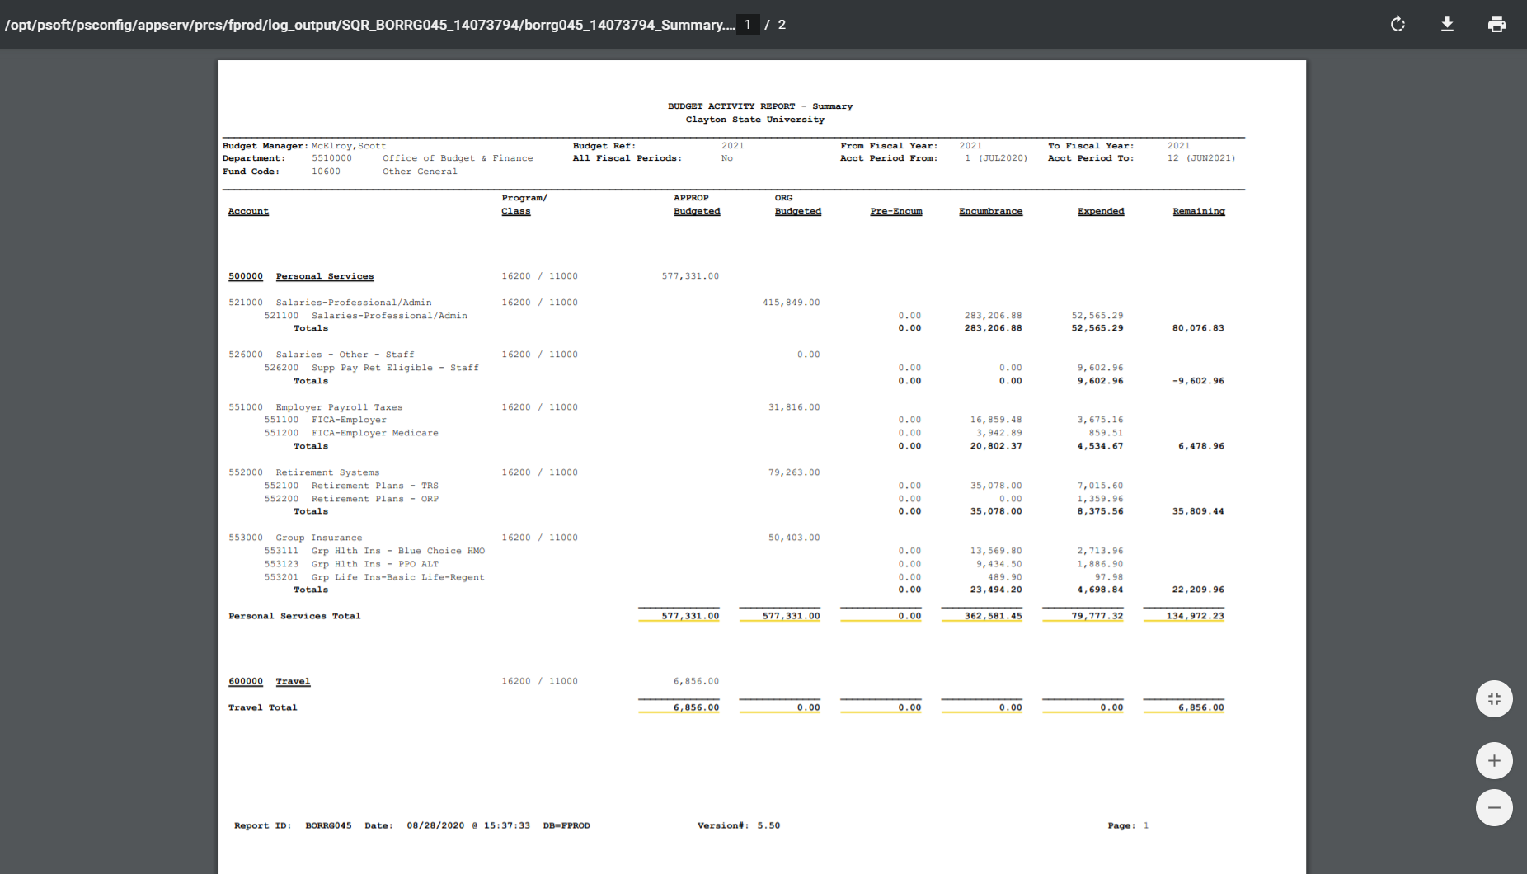

Slide 68

REVENUE SUMMARY
The following screen shots will show you how to access the Revenue Summary Report. This report will give you a quick look at the summary of your revenue associated with your area.
You will need to click on icon in the far upper right-hand corner of the panel which looks like a ‘diamond inside a circle’. This will bring up your NavBar. Once you have the NavBar pulled up, you will click on the Navigator link.

Slide 69
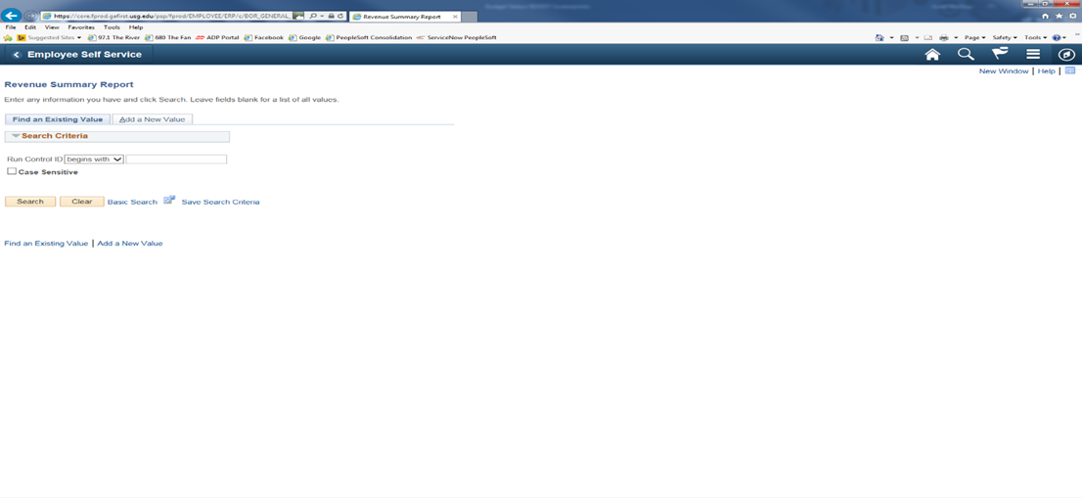
BOR MENUS>BOR GENERAL LEDGER>BOR GL REPORTS>REVENUE SUMMARY REPORT

Slide 70
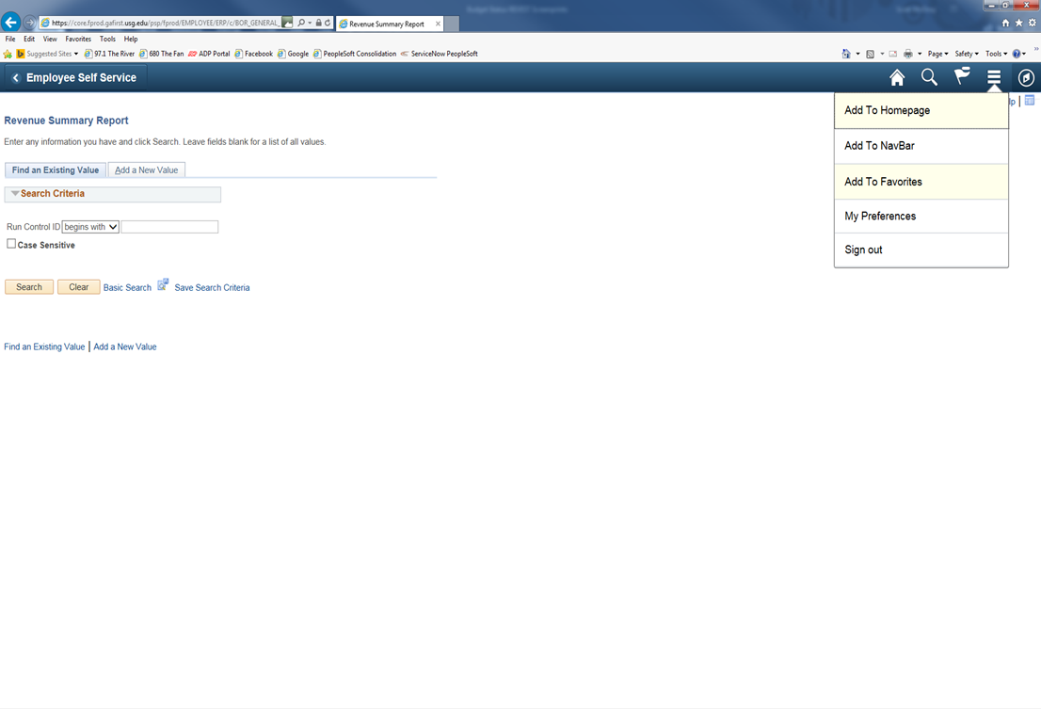
At this time, you can save this process as a favorite for future reference. You just need to click on the icon that has 3 lines in the upper right-hand corner which has a drop-down menu. You will click on Add to Favorites link at the top and enter a description before clicking OK.

Slide 71
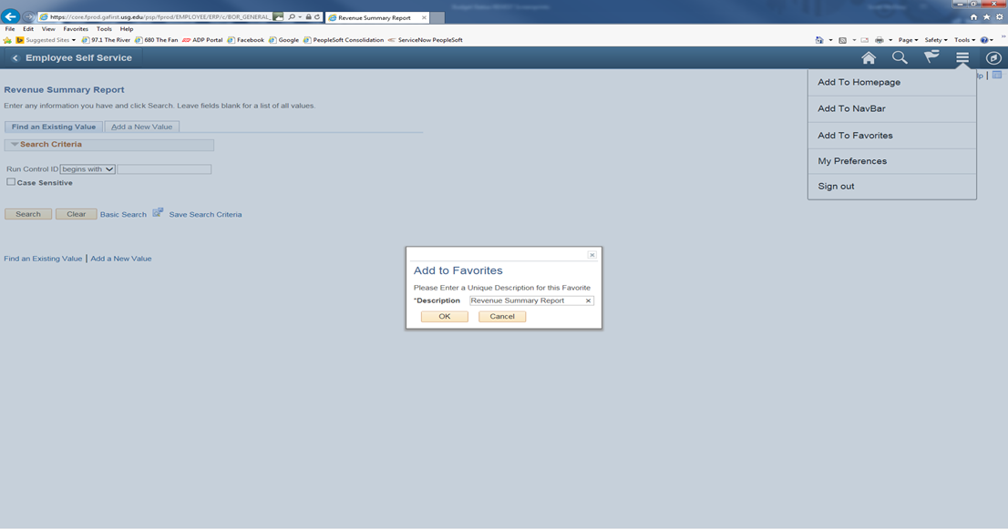
Click on the tab for Add a New Value. You can enter a Run Control ID that you will remember for this report such as Revenue_Summary then click the Add button.
Note: You can’t have any spaces, so you must use underscore in place of any space you wish.

Slide 72
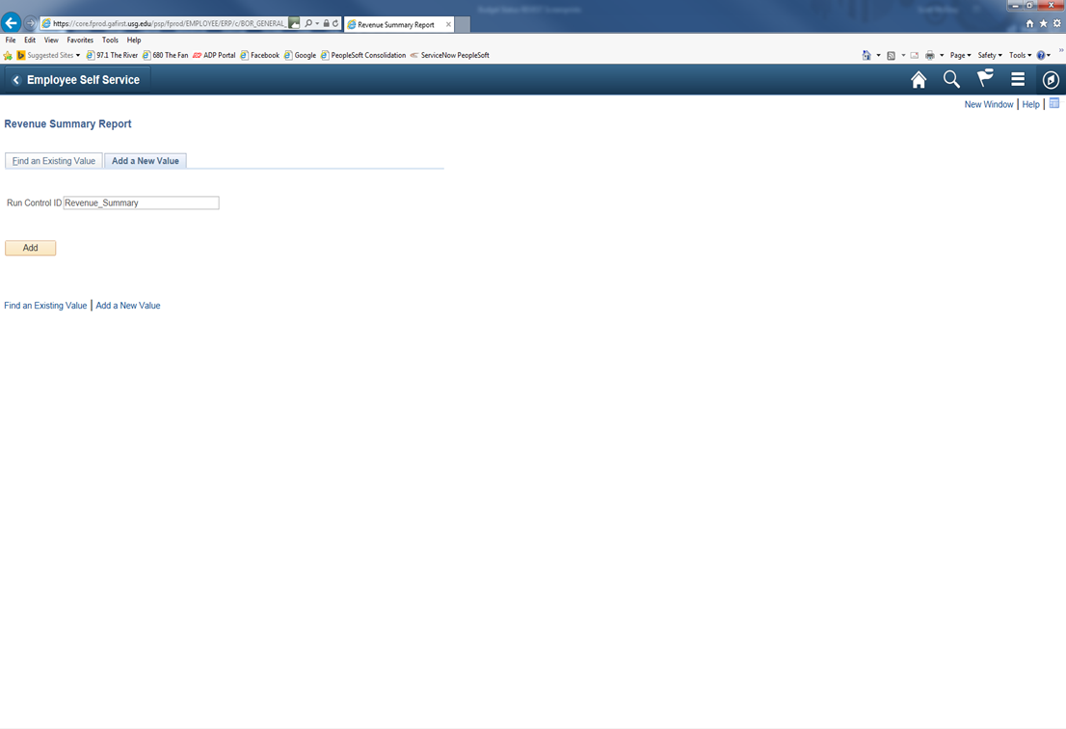

Slide 73
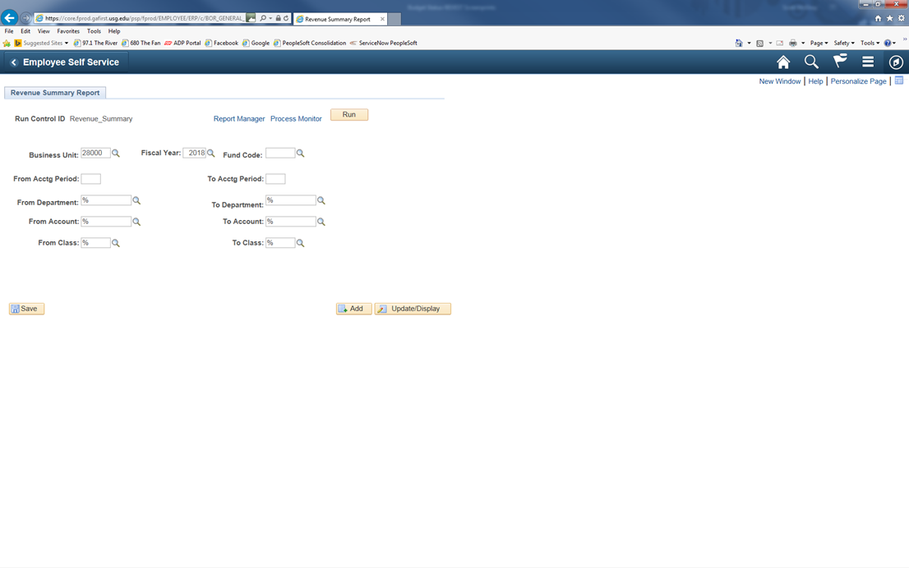

Slide 74
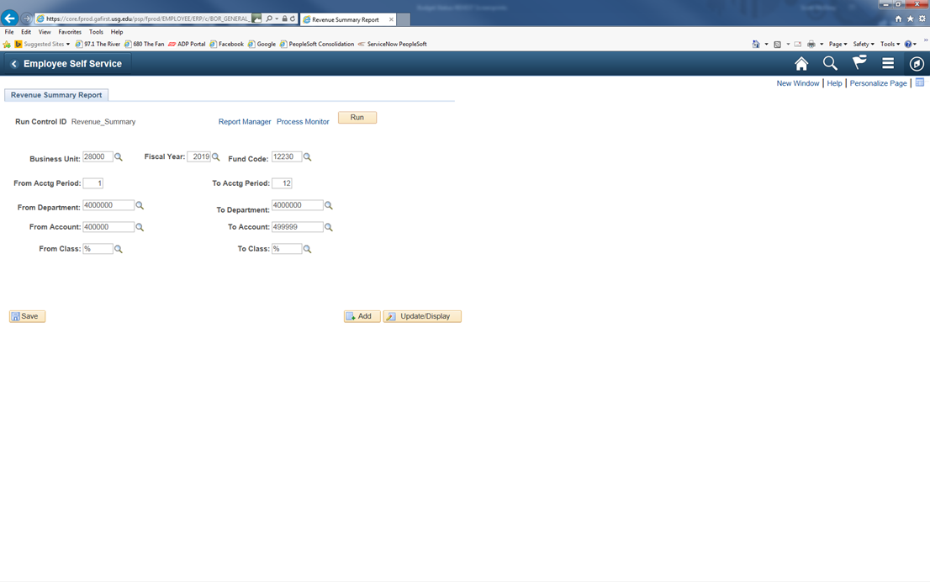
At this time, you would enter all the revenue account information associated with your area. Then click on the Run button at the top to initiate the process.

Slide 75
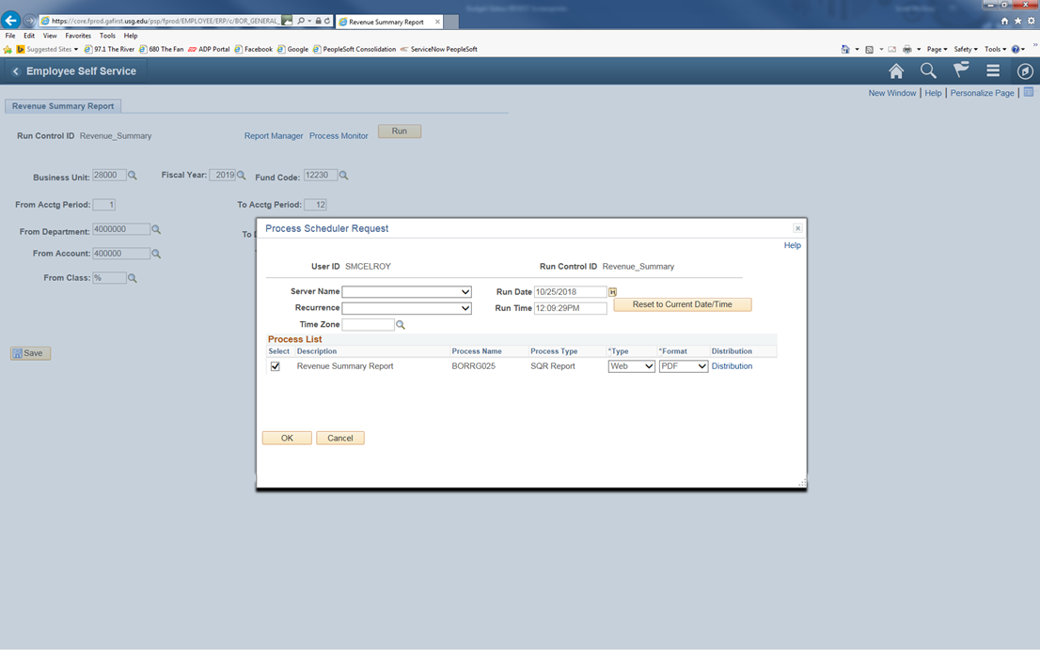
When the Process Scheduler Request screen appears, click on OK to schedule the process.

Slide 76
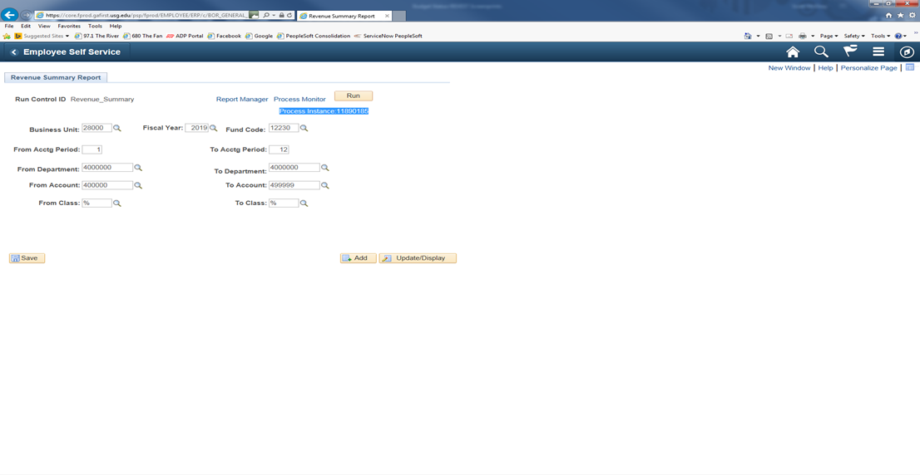
After clicking on OK, it will take you back to the report format screen. You will notice a Process Instance number just under the Run button at the top of the page. You need to make a note of this Process Instance number that will be used in the next section of the process. At this time, you will click on the Process Monitor link.

Slide 77
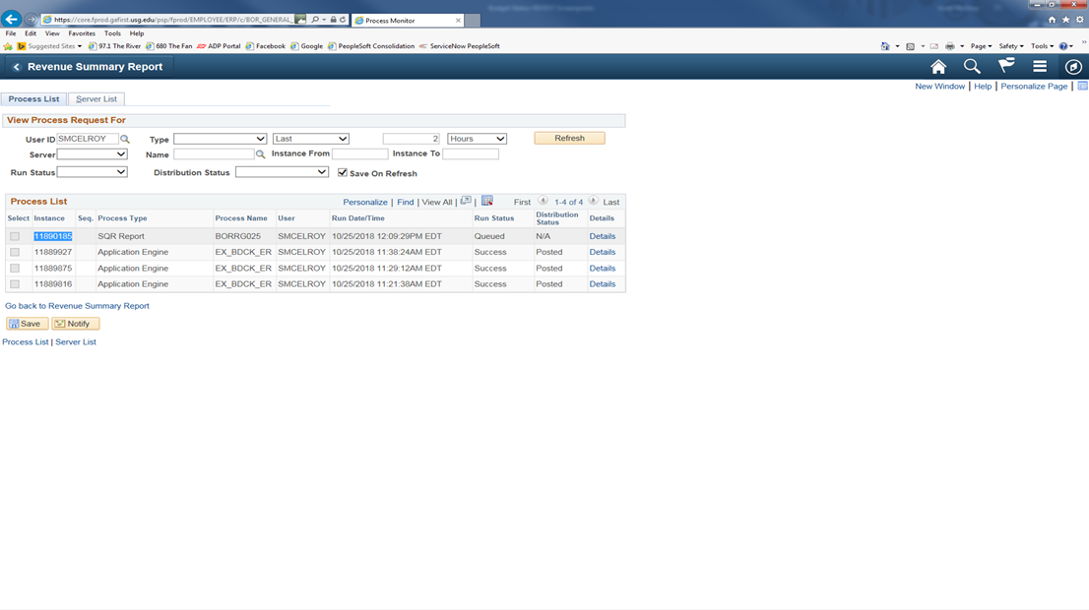
If, at this time the Run Status on your Process Instance doesn’t show as Success or Distribution Status doesn’t show as Posted, you will need to click on the Refresh button at the top until it reaches this status.

Slide 78
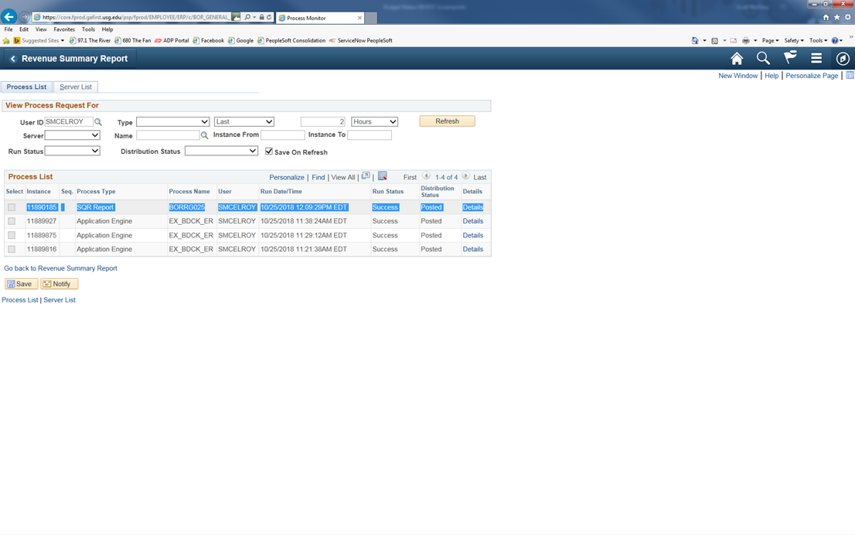

Slide 79

To access the report that you just ran, you will need to click on the Details link in the line for your Process Instance number.

Slide 80
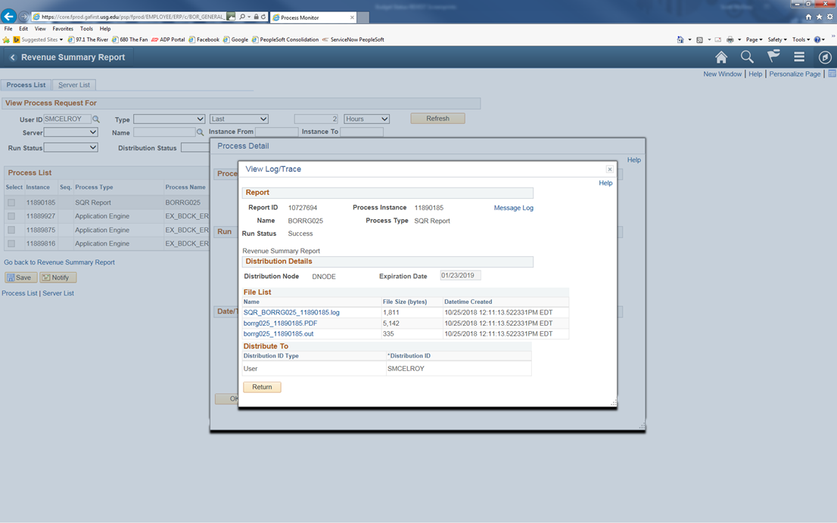
Then from the Process Detail screen, you will click on the link View Log/Trace.

Slide 81

From the View Log/Trace screen, you will click on the link for the PDF file in the File List. This will bring up the Revenue Summary Report that you just ran. You can then either Save As or Print the report.

Slide 82

LEDGER HISTORY REPORT
The following screen shots will show you how to access the Ledger History Report. The Ledger History Report shows a detailed listing of transactions for an individual revenue or expenditure account. However, this report does not provide any budget information on that account. This report is best to use if you have revenue associated with your departmental funding. It provides you with the remaining balance when comparing revenue vs. expenditures.
You will need to click on icon in the far upper right-hand corner of the panel which looks like a ‘diamond inside a circle’. This will bring up your NavBar. Once you have the NavBar pulled up, you will click on the Navigator link.

Slide 83

BOR MENUS>BOR GENERAL LEDGER>BOR GL REPORTS>LEDGER HISTORY REPORT

Slide 84

At this time, you can save this process as a favorite for future reference. You just need to click on the icon that has 3 lines in the upper right-hand corner which has a drop-down menu. You will click on Add to Favorites link at the top and enter a description before clicking OK.

Slide 85

Click on the tab for Add a New Value. You can enter a Run Control ID that you will remember for this report such as Ledger_History then click the Add button.
Note: You can’t have any spaces, so you must use underscore in place of any space you wish.

Slide 86


Slide 87


Slide 88

When completing this page, be sure to:
Check whether you want a Summary report; Detail report; or a Detail report with Beginning Balance and Prior Period totals.
The Ledger is: Actuals
Enter either a range of accounts or just one individual account,
Enter your departmental information (department #, fund code and class).
(The “%” sign is a wildcard in PeopleSoft; use it in any field that you do not have information for).
Click on the Save button to save the parameters for the next time you access this report. Then you will need to click on the Run button at the top to initiate the process.

Slide 89

When the Process Scheduler Request screen appears, you only have the one option Ledger History Report which should already be preselected. You will just click OK to process the report.

Slide 90

After clicking on OK, it will take you back to the report format screen. You will notice a Process Instance number just under the Run button at the top of the page. You need to make a note of this Process Instance number that will be used in the next section of the process. At this time, you will click on the Process Monitor link.

Slide 91

If, at this time the Run Status on your Process Instance doesn’t show as Success or Distribution Status doesn’t show as Posted, you will need to click on the Refresh button at the top until it reaches this status.

Slide 92


Slide 93

To access the report that you just ran, you will need to click on the Details link in the line for your Process Instance number.

Slide 94

Then from the Process Detail screen, you will click on the link View Log/Trace.

Slide 95

From the View Log/Trace screen, you will click on the link for the PDF file in the File List. This will bring up the Ledger History Report that you just ran. You can then either Save As or Print the report.

Slide 96
Budget Amendments
There are times during the fiscal year when budgets must be amended for one reason or another. Budget amendments can be initiated either by the department itself or by the Budget Office. To initiate a budget adjustment, the department must complete a Budget Amendment Request including all vital information. This form along with instructions, tips, and examples can be found at the following link: http://www.clayton.edu/budget/budgetamendments. All budget amendments initiated by the department will need to be signed by all management levels responsible for the budgets changed by the amendment to ensure that all impacted parties are aware of the changes. In addition to the Dept. Head all amendments initiated within the Academic Affairs division must also be approved by the Provost. The form is submitted to the budget department and entered into PeopleSoft.
Amendments initiated by the Budget Office are for budget reductions enacted by the Board of Regents, the President, or Chief Business Officer or for maintenance to the account. Examples of Budget maintenance include (but are not limited to):
• Quarterly Salary Savings
• Adjustment of miscellaneous revenue
• Adjust Tuition Revenue
• Student assistant funding
The Budget Office will notify the impacted Budget Manager via email if any of the above amendments affect their departmental budget.

Slide 98


Slide 99


Slide 100


Slide 101


Slide 102


Slide 103


Slide 104


Slide 105

QUESTIONS

