Slide 1
Banner Class Schedule Training

Slide 2
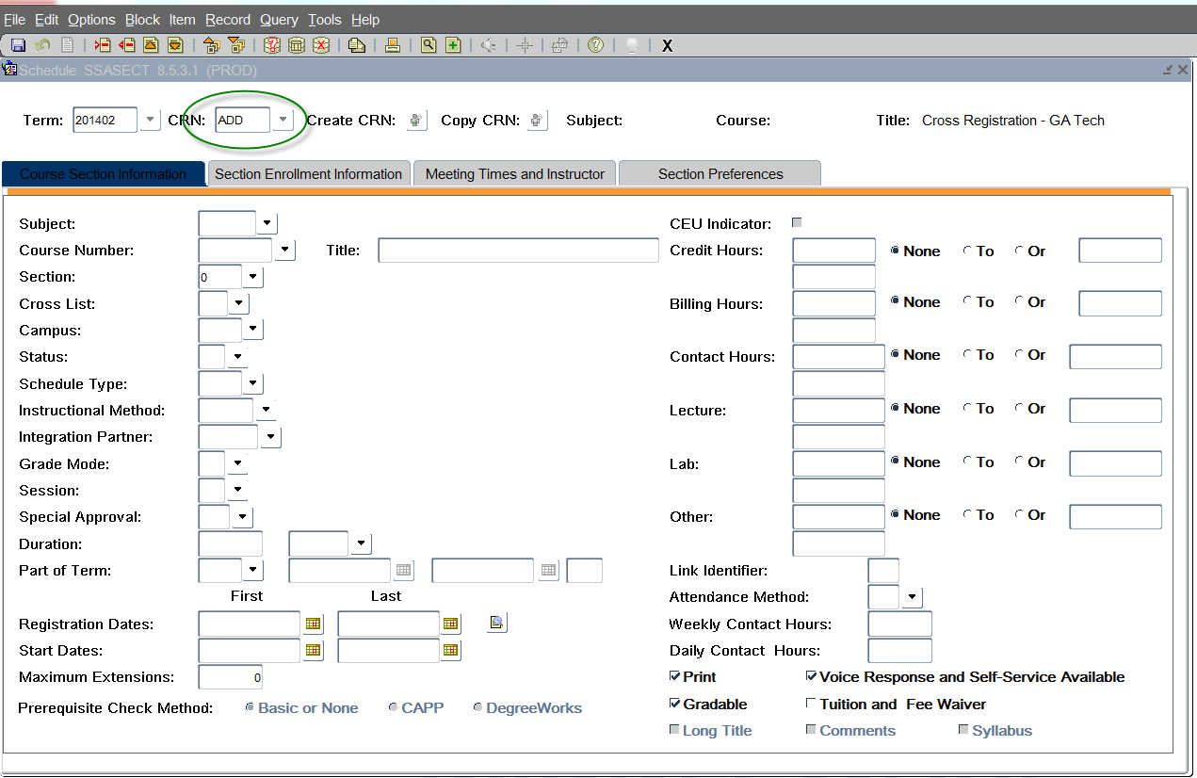
SSASECT

Slide 3
Section Numbers
Seated Courses
Below 30 – Full Semester
30 – First half semester
50 – Second half semester

Slide 4
Section Numbers
Online Courses
40 – First half semester
60 – Second half
90 – Full Semester
**G - eCore

Slide 5
Schedule Type, Instructional Method, and Session
Schedule Type – How is the course being taught?
Instructional Method – numeric value that coincides with the Schedule Type that we communicated to the USG via the Academic Data Collection (ADC). This information will automatically populate in SSASECT once you enter in the schedule type information.
Session – Room Specification.
A – on campus with assigned space, you must have a room number.
B – on campus with unassigned space, please do not enter in a room number.
N – class needs a room, please do not enter in a room number.

Slide 6
Campus Based Courses
Classroom Based Type of Class | Schedule Type | Instructional Method | Session (Room Specification)
Lecture | A | 10 | A or B
Lecture/Supervised lab or clinic | B | 11 | A or B
Lecture/Unsupervised lab or clinic | B | 11 | A or B
Seminar | D | 20 | A or B
Supervised lab or clinic | E | 40 | A or B
Independent Study | G | 50 | A or B
Internship | N | 81 | A or B

Slide 7
Online Based Courses
Online Based Type of Class | Schedule Type | Instructional Method | Session (Room Specifications)
Independent Study | G | 50 | B
Asynchronous/Online | M | E, F, or P | B
Hybrid | M | H | A
Hybrid | M | H | B
Internship | N | 81 | B

Slide 8
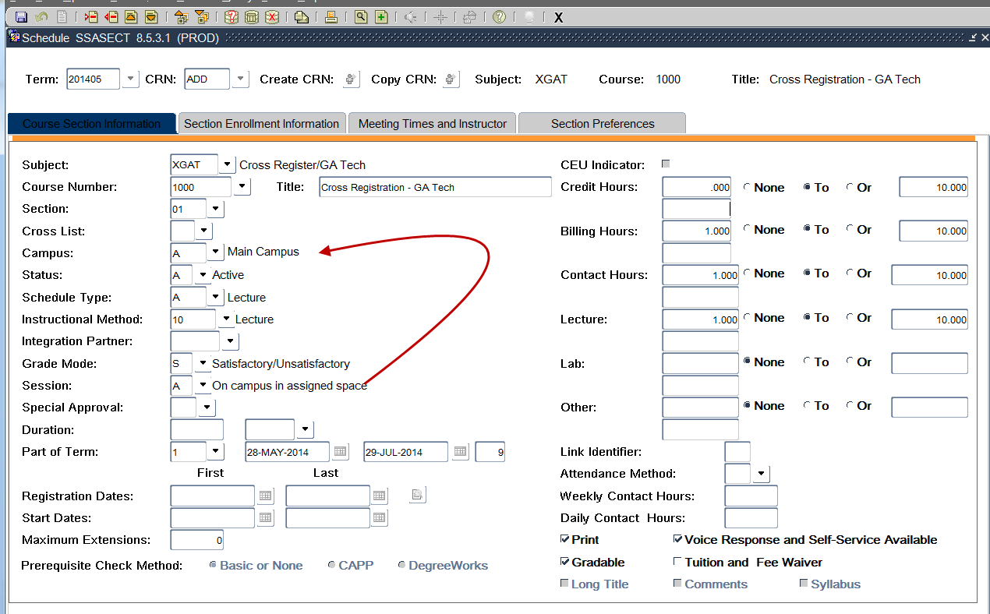
Campus and Session Must Agree

Slide 9
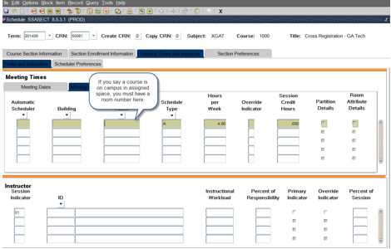
Session and Room Assignment Must Agree

Slide 10
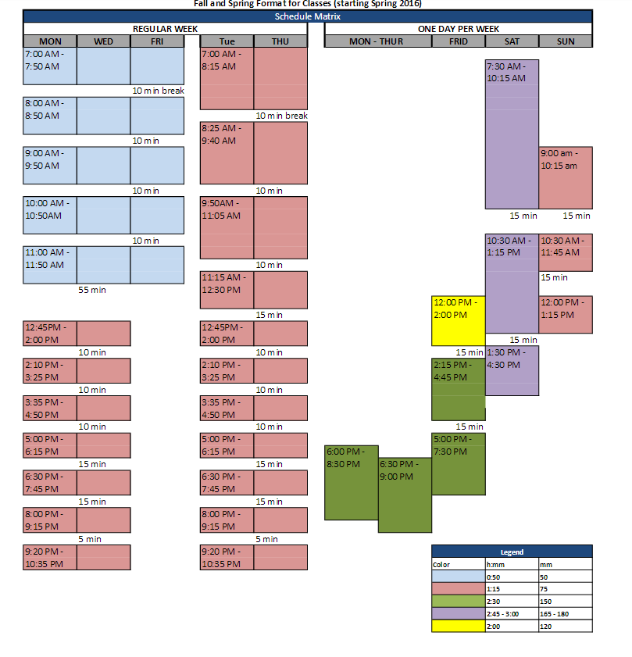
Fall & Spring Matrix

Slide 11
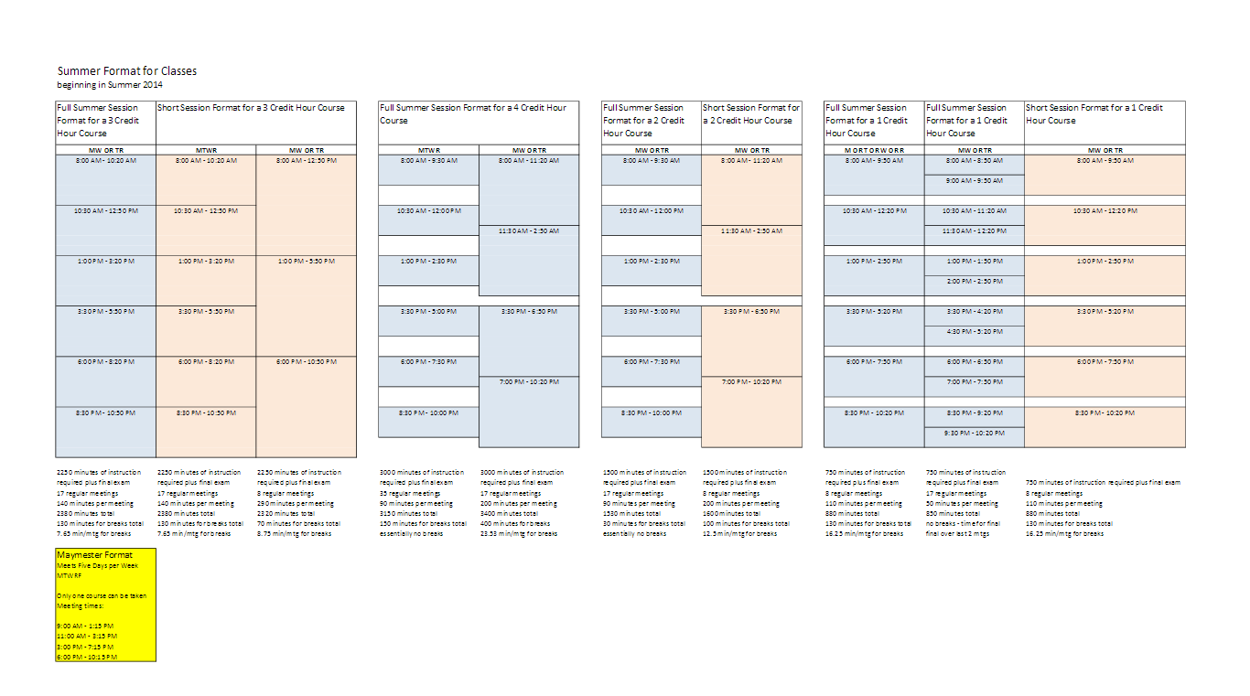
Summer Matrix

Slide 12
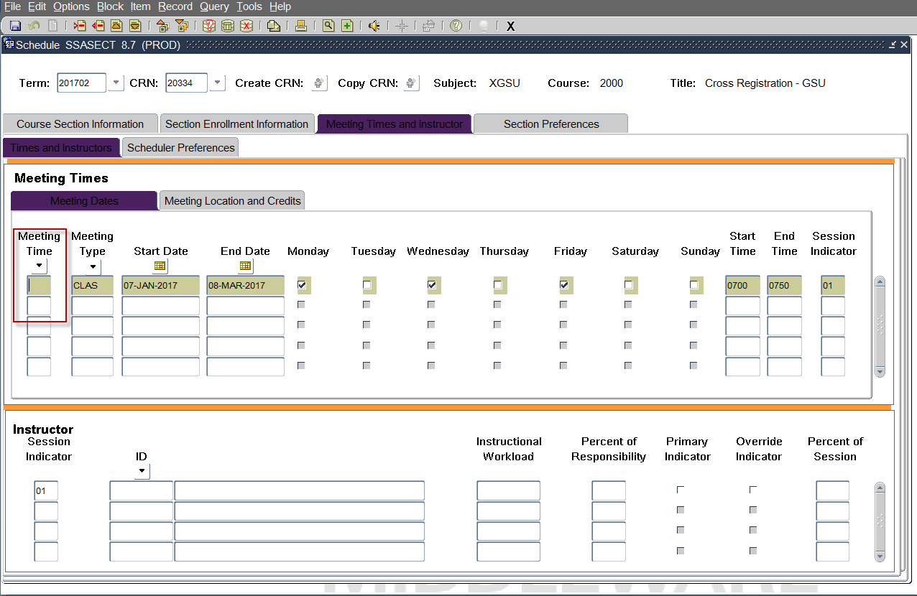
Meeting Times Matrix

Slide 13
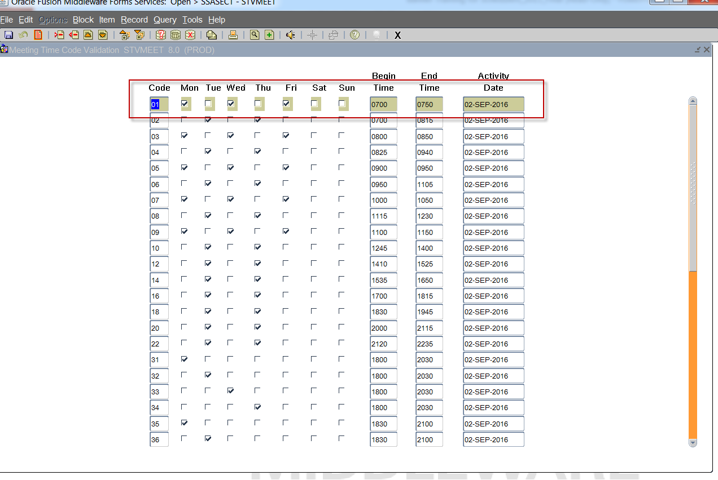
STVMEET: Pre-Populated Matrix

Slide 14
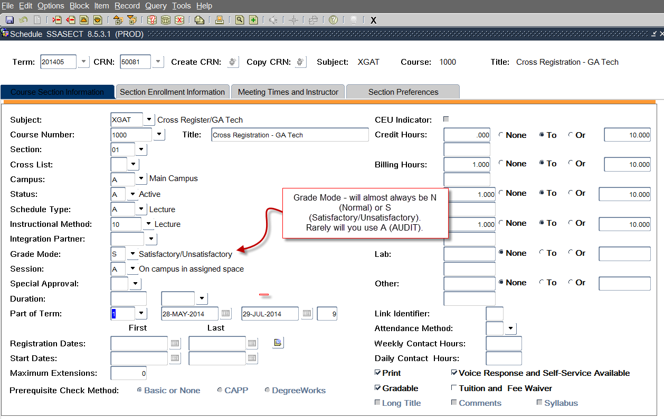
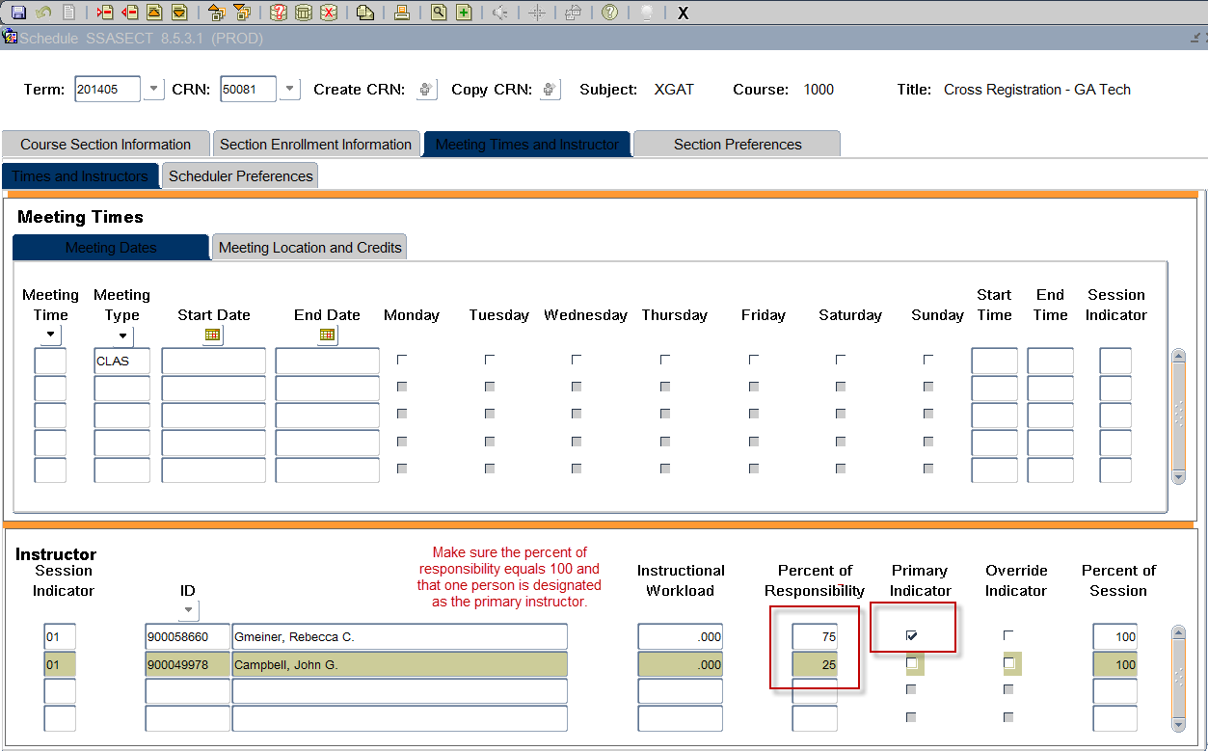
Grade Mode & Instructor
Grade Mode (Audit Warning)
Instructor

Slide 15
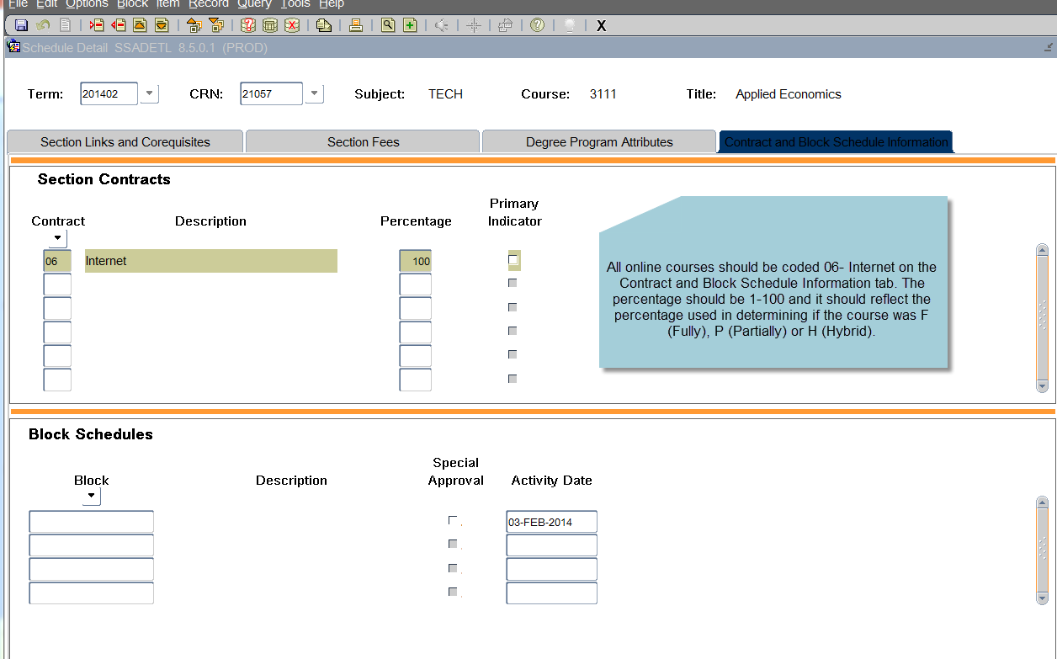
SSADETL for Online Courses

Slide 16
Additional Scheduling Screens
SSATEXT – add section comments that will appear on schedule posted to the web.
For online courses the following must be present “This course requires substantial online coursework and will be assessed an online course fee and other mandatory fees as applicable.”
SSAPREQ – add pre or co-requisites for a specific section.
SSARRES – add a restriction for just this section
SSAMATX – after the schedule is complete, if you need to change rooms you can use this screen to fine out what is available.

Slide 17
Cross-Listing Courses
Cross-listed courses are used when you want to tie two courses together that meet at the same time and are taught by the same instructor.
Reserve seats for a specific population
Allows the same course to be taught using a unique subject and course number. EXAMPLE: CRJU 4426 and POLS 4426 are the same course.

Slide 18
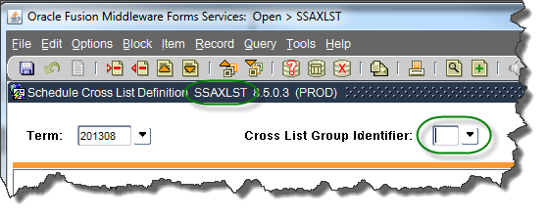
Searching for Cross Lists From SSAXLST
Unlike a CRN, the cross-listing code is not assigned by Banner. Banner will only tell you if the code you have selected is being used by another course.
Search SSAXLST to see if the code you want to use is currently being used by another course
Create the code. Suggestion – try to use something that makes sense to your department. Example – Biology might use B1, B2, B3, etc.

Slide 19
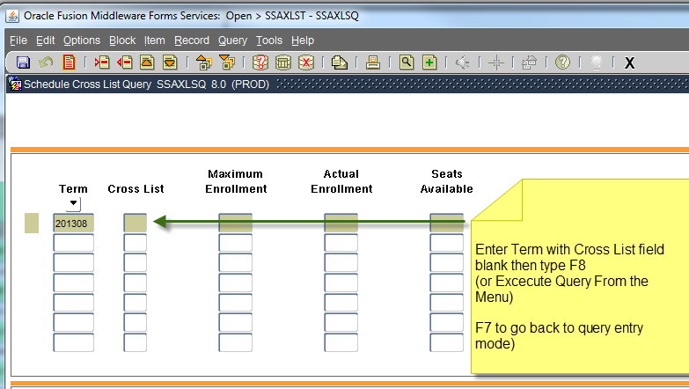

Slide 20
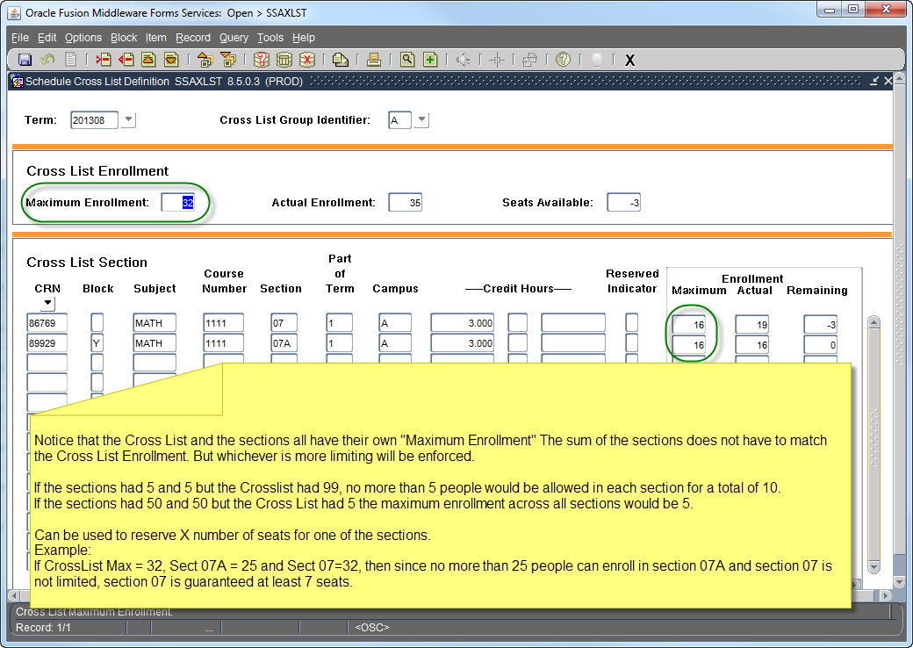
Entering New Sections (SSAXLST)
Cross List codes can be any Alphanumeric character. As a general rule, Cross Lists associated with a Learning Community are named after the Learning Community. (“A” in this example)

Slide 21
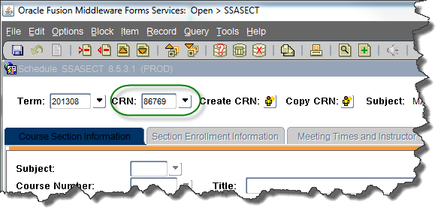
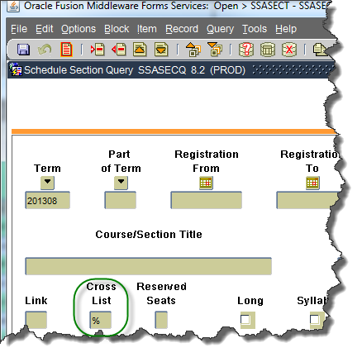
Searching for Cross Listed Sections
From SSASECT, enter a term, place cursor in CRN field and click arrow or F9
From the Query Form, enter the Term and put a % in the Cross List field then press F9

Slide 22
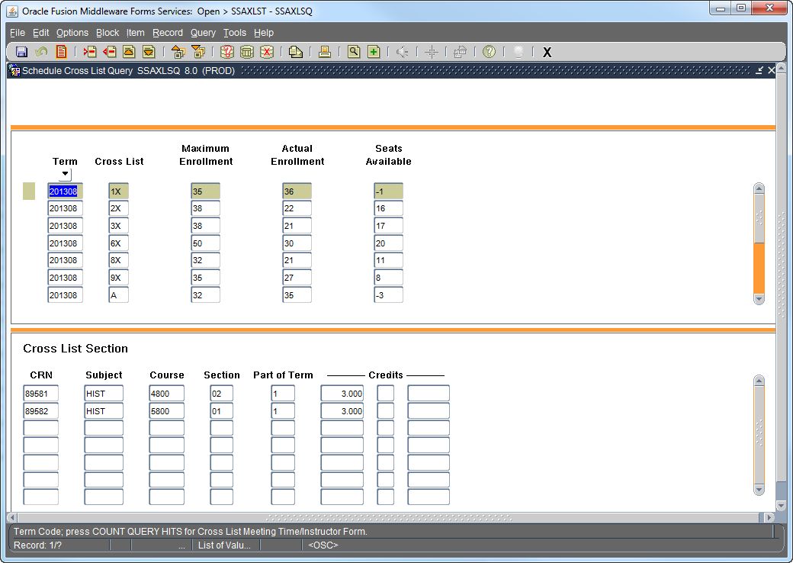
Press F8 to execute query

Slide 23
Useful Links
Coding classes in Banner: http://www.clayton.edu/cid/Banner
Fall & Spring Schedule Matrix (beginning Spring 2016): http://www.clayton.edu/Portals/549/Fall%20and%20Spring%20Format%20for%20Classes%20%28starting%20Spring%202016%29.pdf
Summer Matrix: http://www.clayton.edu/Portals/549/Copy%20of%20SummerClassFormat2014.pdf

Slide 24

Questions
Notes:
Registrars are custodians of students' records. They register students, record grades, prepare student transcripts, evaluate academic records, assist with the collect tuition and fees, plan and implement commencement, assist IT with the maintenance and security of the student records system.

