Slide 1

Master’S of Science in Clinical/Counseling Psychology
(MPCAC Accredited)
Clinical practicum expectations & requirements

Slide 2
Our program sincerely appreciates this partnership.
Thank you!

Slide 3
Partnerships with practicum sites
Healthy and productive partnerships with local mental health organizations are central to the practicum experience.
The MOU between CSU and community partners states multiple goals and responsibilities.
The broad aims for this partnership include:
Students enhance their professional development via application and integration of classroom theory and training in the context of supervised clinical work experiences.
Sites work with teachable trainees who provide quality clinical services to the target population.

Slide 4
practicum SITE requirements
Students need 600 hours over a minimum of nine months.
Students need a minimum of three individual clients at any given time.
There must be a licensed counselor, social worker, or psychologist on staff. Licensure requirements:
  Supervisors must be fully licensed a minimum of 3 years at the master’s level and 1 year at the doctoral level
  Supervisors are not required to be full-time employees of the agency
Sites must provide one hour of individual clinical supervision per week. This should include no more than two trainees for the one hour of supervision period.

Slide 5
practicum SITE requirements
Sites must always have a licensed (or licensure eligible) professional on site with the student.
  This person does not have to be the formal supervisor but needs to be someone who can support if the student has a client in crisis or some other unforeseen clinical circumstance arises where the student will need guidance
Supervisors are required to approve hours regularly throughout the semester using the Time2Track software.
Site supervisor will have to complete a formal evaluation of student progress at least twice per year (December and May).
Students will provide their own malpractice insurance.

Slide 6
practicum SITE requirements
Students are not allowed to provide in home therapy.
The Memorandum of Understanding (MOU) expires after 5 years but sites have the right to request the MOU for a lesser term. Please note, our MOUs aren’t binding in the sense that you must take our students each year. The five-year period simply eases the process for the sites that do offer placement every year.

Slide 7
practicum SITE requirements
Unless the student has behaved unethically, endangered clients and/or staff, or has severe/chronic issues with professionalism sites must give 60 days’ notice before terminating a student due to site related issues. In instances where 60 days may not be attainable, site must make efforts to reassign students within the agency when available.
Sites are required to make provisions for recording (audio or video) sessions for periodic review as part of clinical supervision.

Slide 8
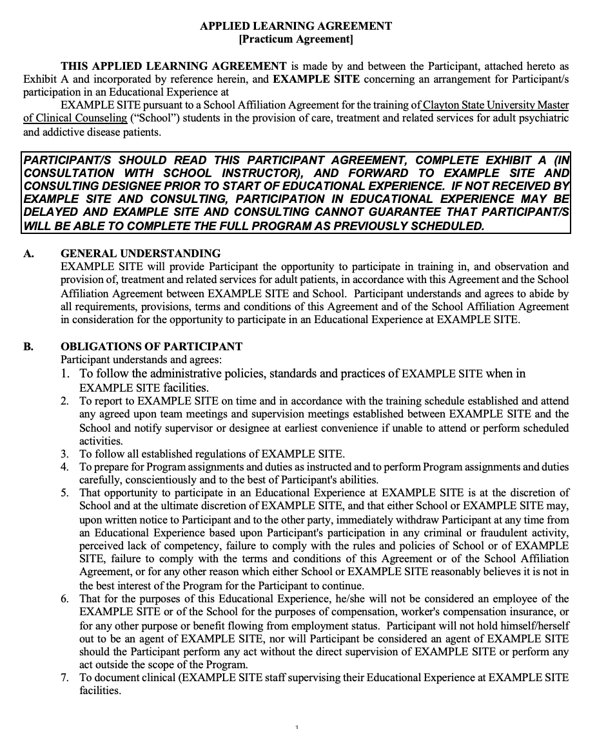
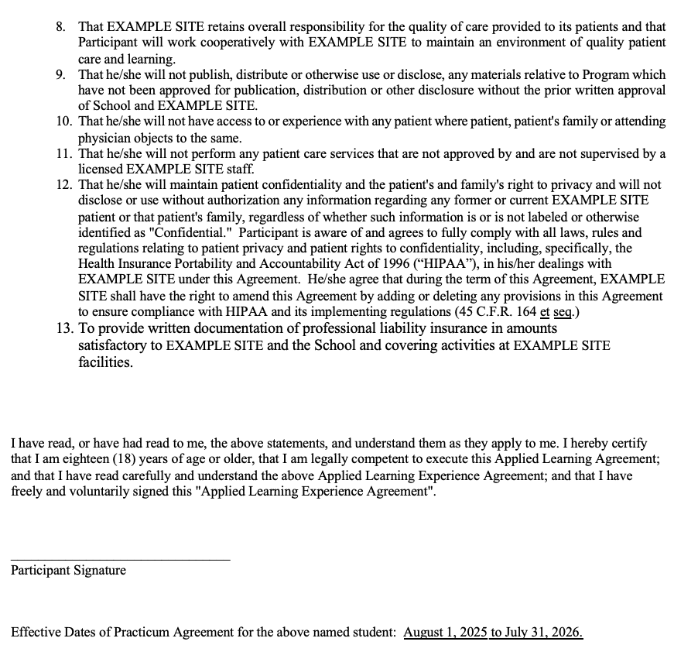
REQUIREMENTS OF STUDENTS
All students sign an Applied Learning Agreement on Day 1 of the Practicum Course.

Slide 9
WHAT NEXT?
Sites can review existing MOUs or look forward to reviewing the MOU that will be sent to them.
Once students have been accepted at your practicum, note that the official start date is August 1. If there are trainings or onboarding activities that must be completed prior to August 1, please notify the students (with the understanding that those activities will not count towards their hours).
THANK YOU!

