Slide 1

Active Learning
Classroom Workshop
Summary Report
Clayton State University
April 11, 2019
Notes:
Welcome and introductions
Note: This presentation is about education trends and research, not SES as an organization. Consider using the SES one-page overview as a handout to accompany this presentation.

Slide 2
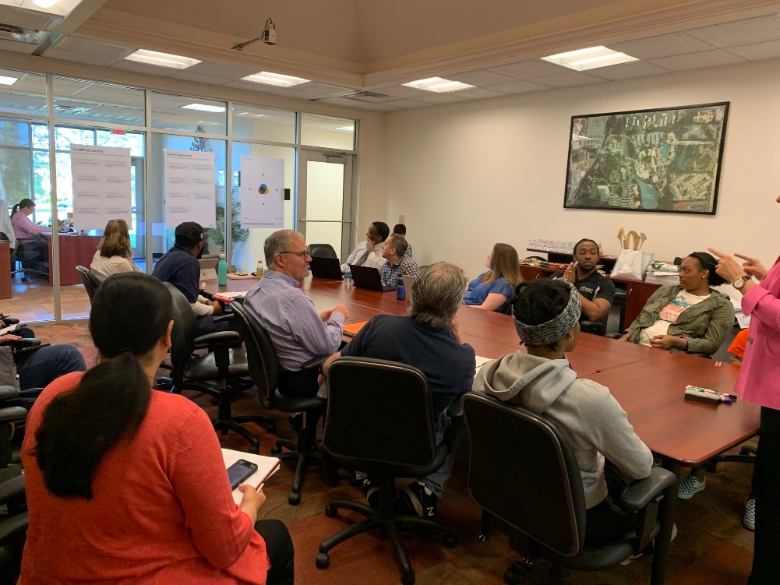
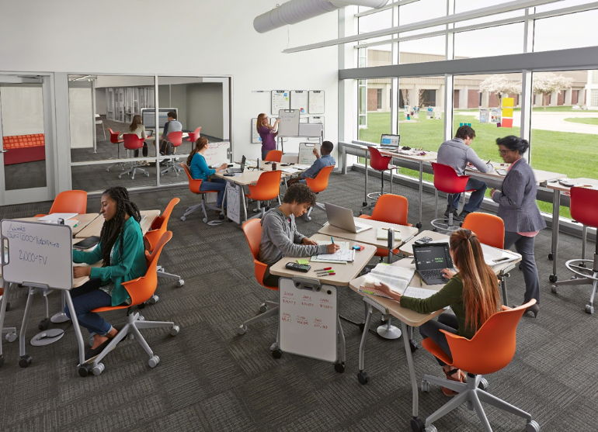
Workshop Overview:
*Classroom Discovery Exercise: Poster based group activity prioritizing the classroom issues most relevant to Clayton State University
*Brief share of research on the key trends and classroom issues colleges and universities face today: Introduce the value of the Active Learning Ecosystem – Pedagogy, Technology, Space
*Group activity and share around the Active Learning Ecosystem – Pedagogy, Technology, Space: Discuss what opportunities and challenges that CSU has with these key elements today
*trending Classroom Design Application review

Slide 3
discovery exercise discussion summary
In a Discovery Exercise discussion, we explored a broad range of classroom issues. Our goal was to prioritize and align on the top issues that impact your institution. We discussed the physical space implications of each and opportunities to explicitly support students and instructors within your institution.
Within this document, we have summarized the issues that were identified as the highest priorities. Let’s review the discussion and understand potential next steps.
contents include
Intent
Issues and priorities
Space implications and next steps
Discovery Exercise | Education

Slide 4
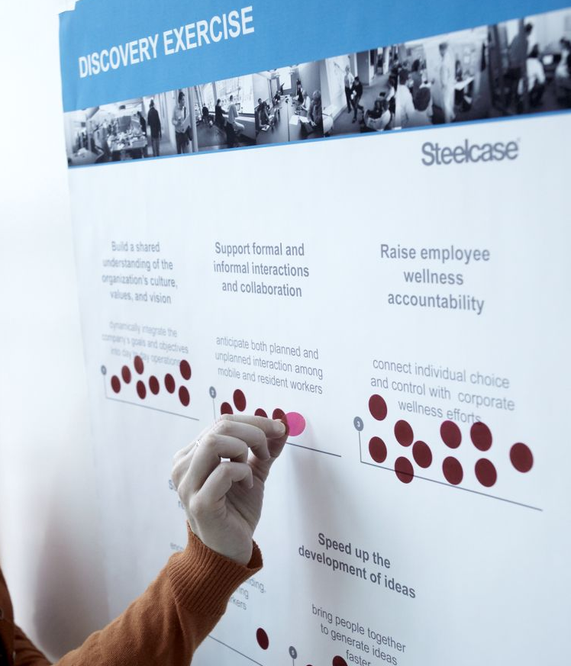
discovery exercise
intent
prioritizing classroom issues
Students, technology and pedagogies are ever-changing, yet the classroom hasn’t changed for decades. The learning places that served us well for years may be out of sync with our needs. The Discovery Exercise allows you to step outside of the flow of change.
Our discussion included:
Identification of key classroom issues and priorities that may be impacting your institution
Determination of the importance of 16 workplace statements. Each participant ranked their top
five statements.
A dialogue regarding the top 5 statements for the
collective group
A group discussion helped us understand the results and discover key insights for your institution.
Photo of a Discovery Exercise poster
Discovery Exercise | Education

Slide 5
issues and priorities

Slide 6
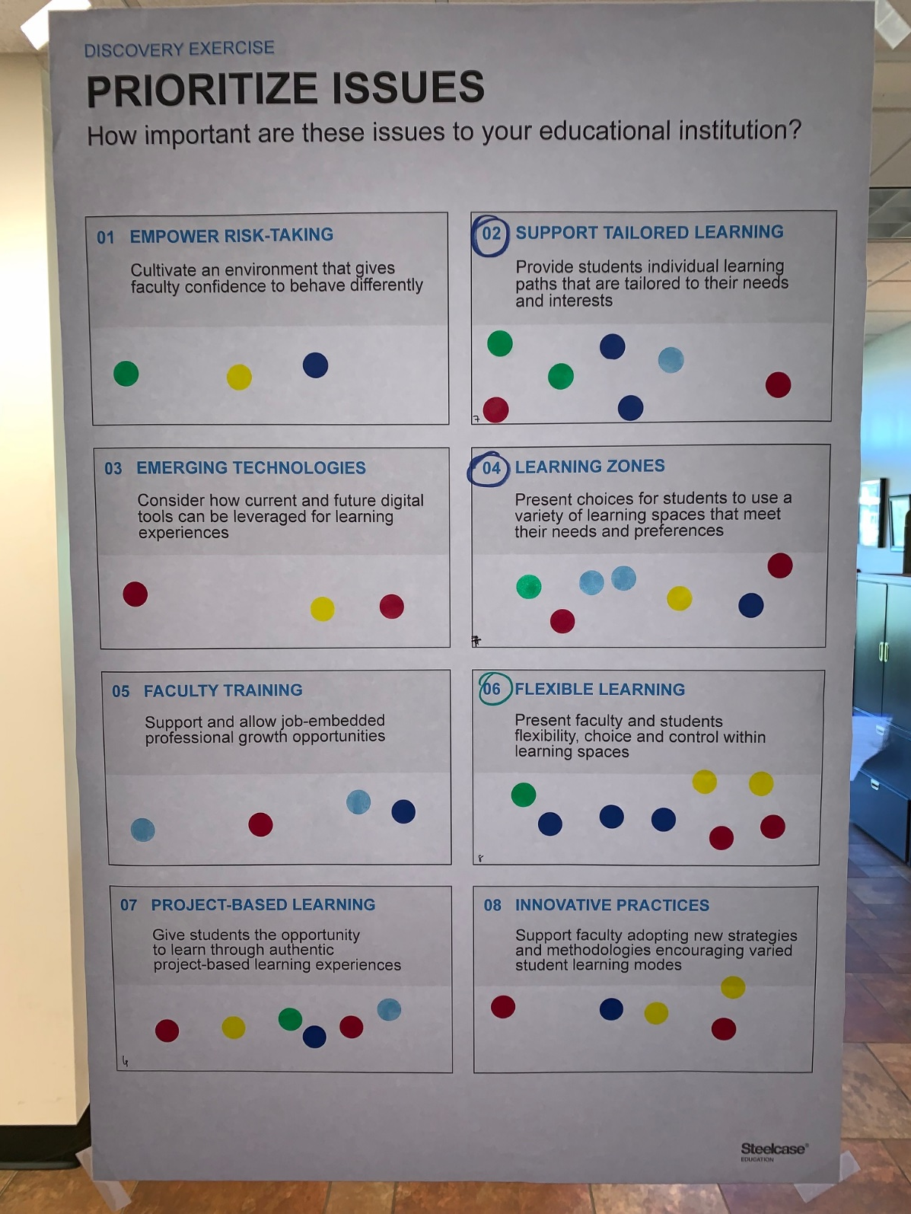
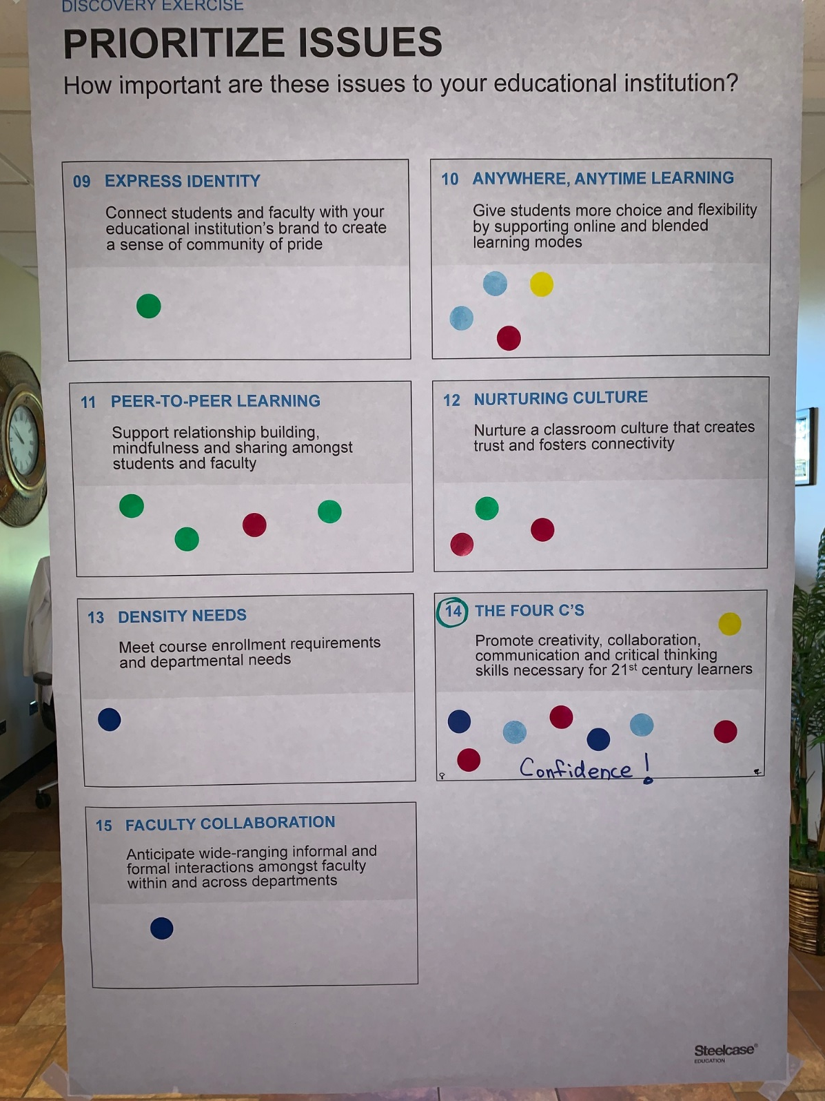

Slide 7

discovery exercise discussion
issues and priorities
The most significant issues
identified include:
1. (tie) Flexible Learning: Present faculty and students flexibility, choice and control within learning spaces
1. (tie) The 4 C’s: Promote creativity, communication, collaboration and critical thinking skills necessary for 21st century learners
2. (tie) Support Tailored Learning: Provide students individual learning paths that are tailored to their individual needs and interests.
2. (tie) Learning Zones: Present choices for students to use a variety of learning spaces that meet their needs and preferences.
5. Project Based Learning: Give students the opportunity to learn through authentic project based learning experiences.
.
Discovery Exercise | Education

Slide 8
(tie) Flexible Learning: Present faculty and students flexibility, choice and control within learning spaces
  Discussion:
  *May need to be configured differently on the activity or how a student is emotionally feeling – need to adapt to day-to-day
  *Needs to be flexible space – open depending on the task – be modular – different subjects use the same spaces.
  *Student agrees – difference between traditional students and those that may have more going on in their lives.
  *Want to break out and need to rearrange room – these tables should have wheels so can reconfigure.
(tie) The 4 C’s: Promote creativity, communication, collaboration and critical thinking skills necessary for 21st century learners
  Discussion:
  *Student – people who drop out are those that can’t be committed to the learning environment. Can’t talk confidently and can’t think critically because classrooms not helping it.
  *Try to teach them confidence. Struggle to get them to realize why they teach them these things – get imposter syndrome where students don’t think they know stuff.

Slide 9
2. (tie) Support Tailored Learning: Provide students individual learning paths that are tailored to their individual needs and interests.
  Discussion:
  *Have to take classes you “need” but are bored.
  *Not understanding why have to take these core classes.
  *Teachers don’t prioritize you because they know you aren’t in the major.
  *Different students learn in different ways. – Project versus online versus lecture, etc. – Need to consider all these.
  *Have students ranging from high school to 70s – different needs – some just learning for enjoyment.
2. (tie) Learning Zones: Present choices for students to use a variety of learning spaces that meet their needs and preferences.
  Discussion:
  *Ability for students to find a place elsewhere to discuss work.
  *Student – varied ages – have to find a common meeting ground because live different places, athletes, jobs – Where and when to meet
  *College of business has areas to study, so don’t have to go to a library – want more of this
  *Student – Suggested they have class outside
  *Learning in day of technology – choice to work where want to.
5. Project Based Learning: Give students the opportunity to learn through authentic project based learning experiences.

Slide 10
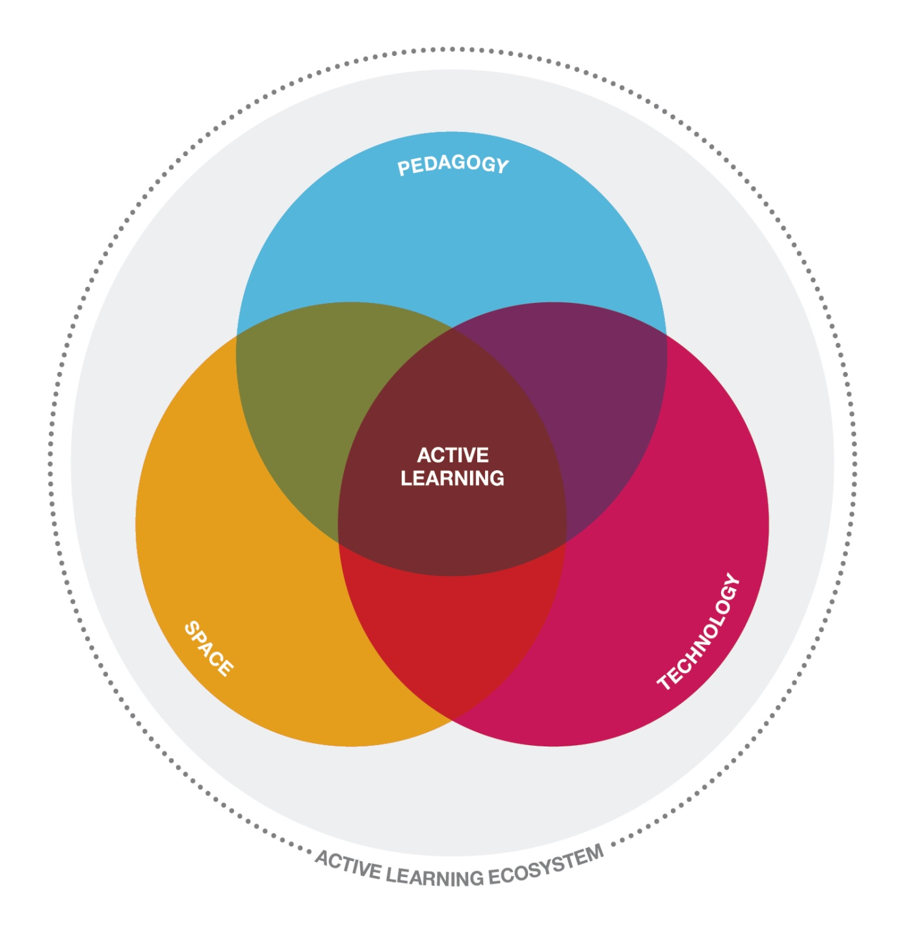
HUMAN-CENTERED DESIGN PROCESS
a new
ecosystem
of active
learning
Notes:
Ideal ecosystem
Pedagogy [or teaching strategies]
Technology as a tool to support pedagogy
Space as a tool to support both

Slide 11
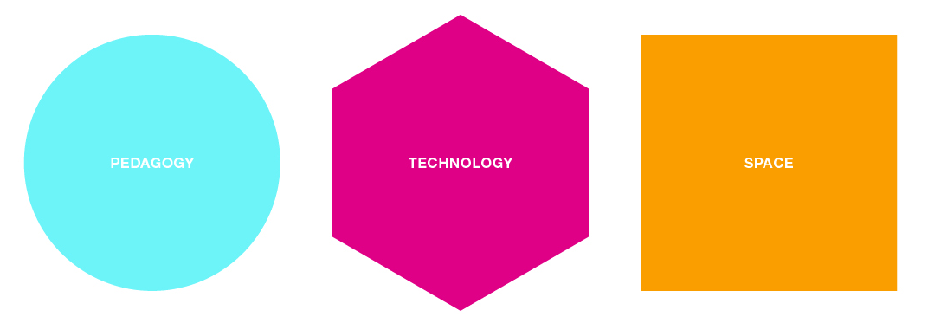
what challenges/opportunities are
you facing?
Notes:
Considering these three areas, think about what challenges your institution is facing?
OR
Why is all of this important?
[No group input, but have them start to think about these issues]

Slide 12
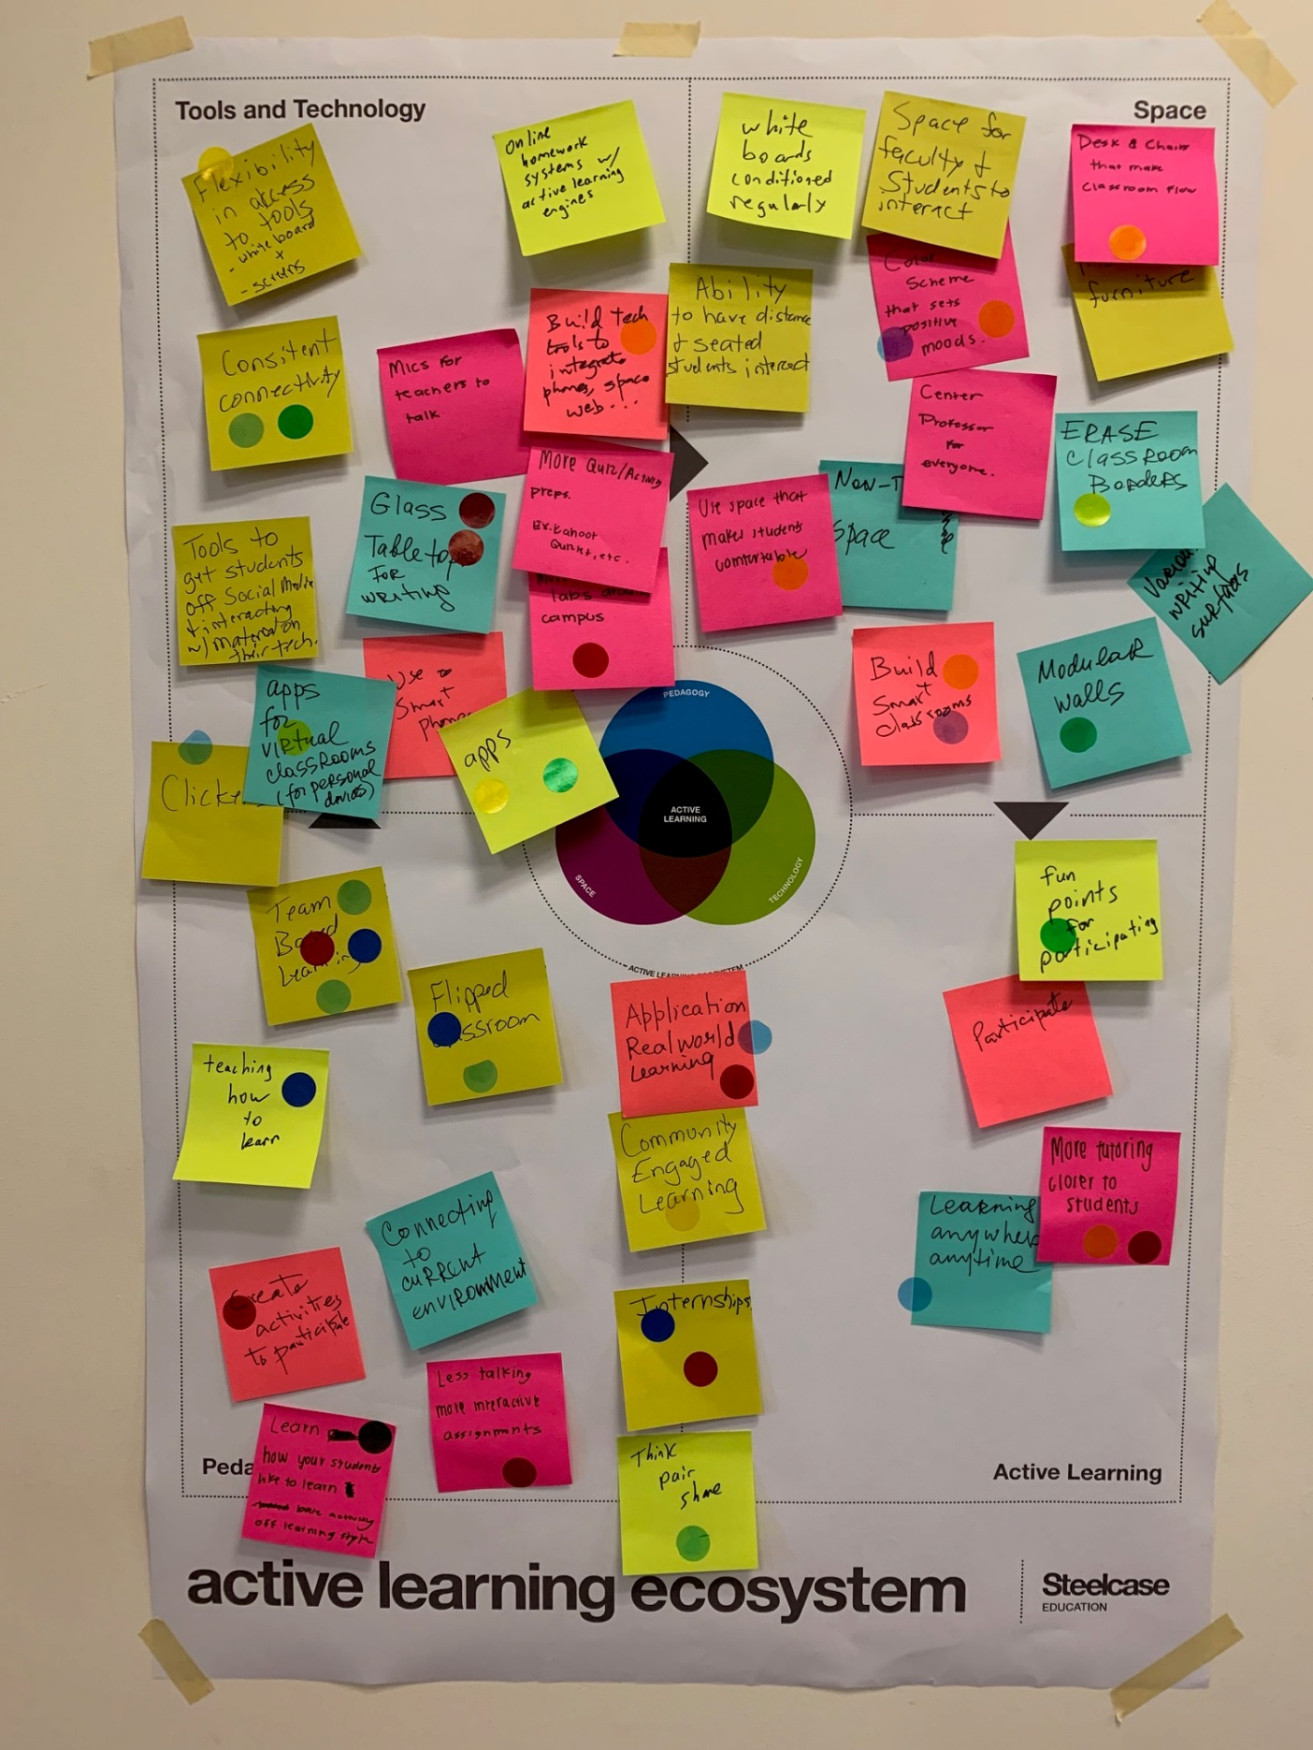
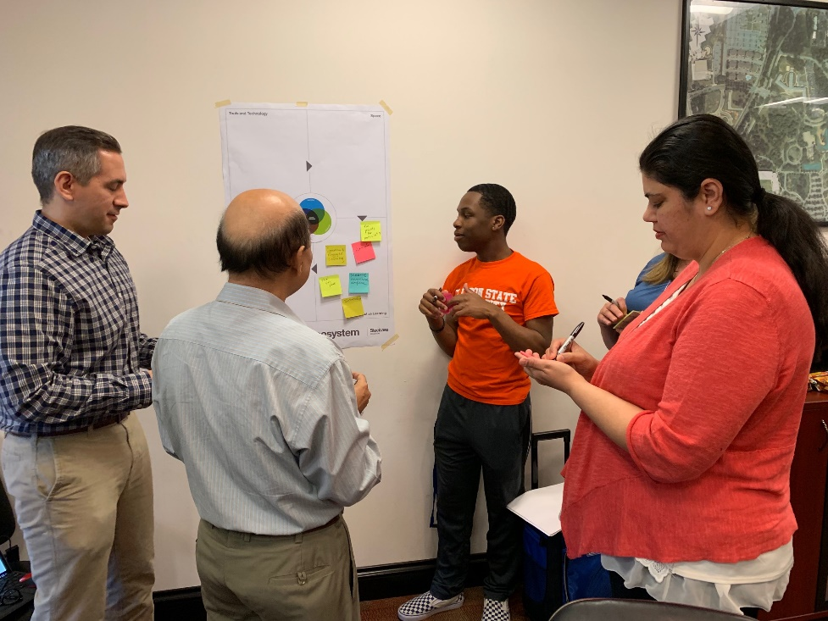

Slide 13
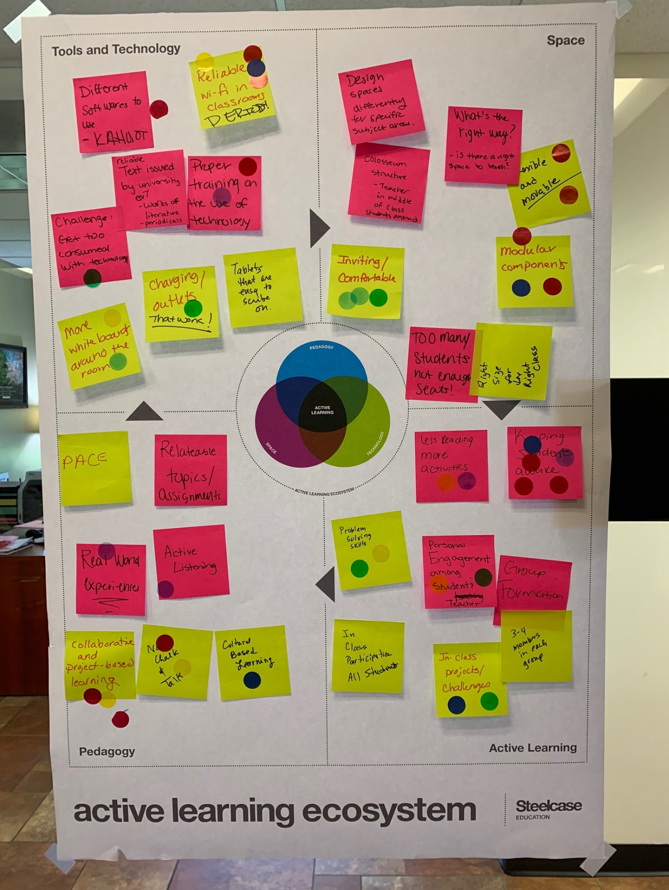
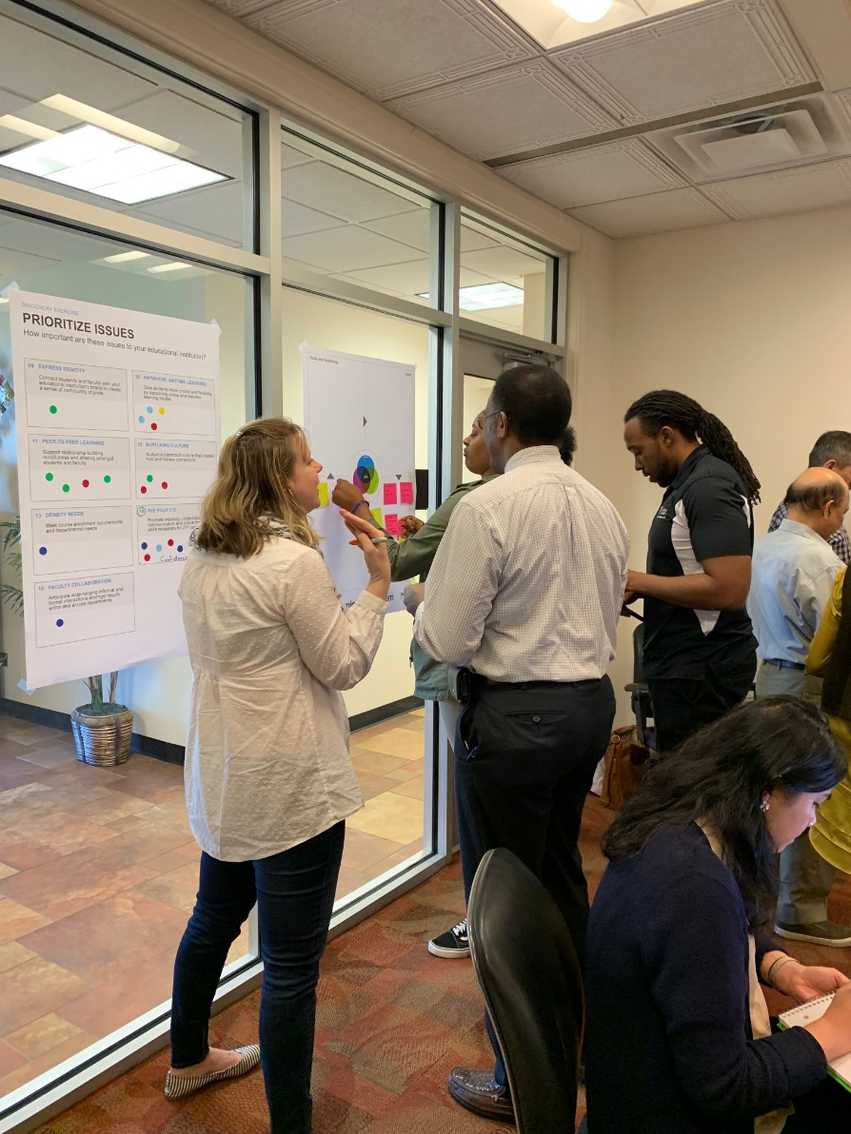

Slide 14
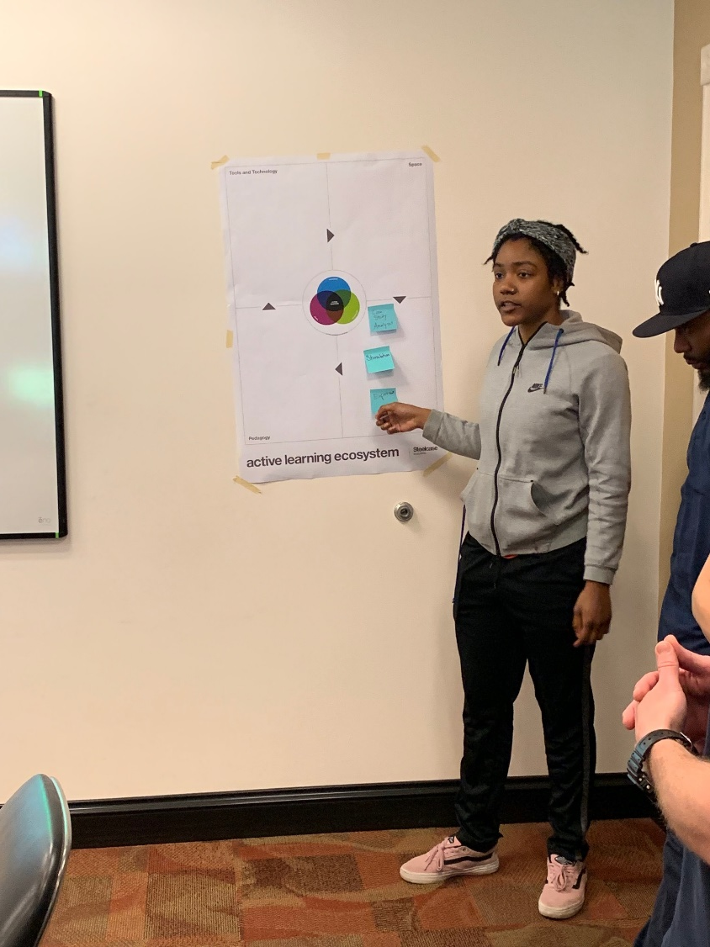
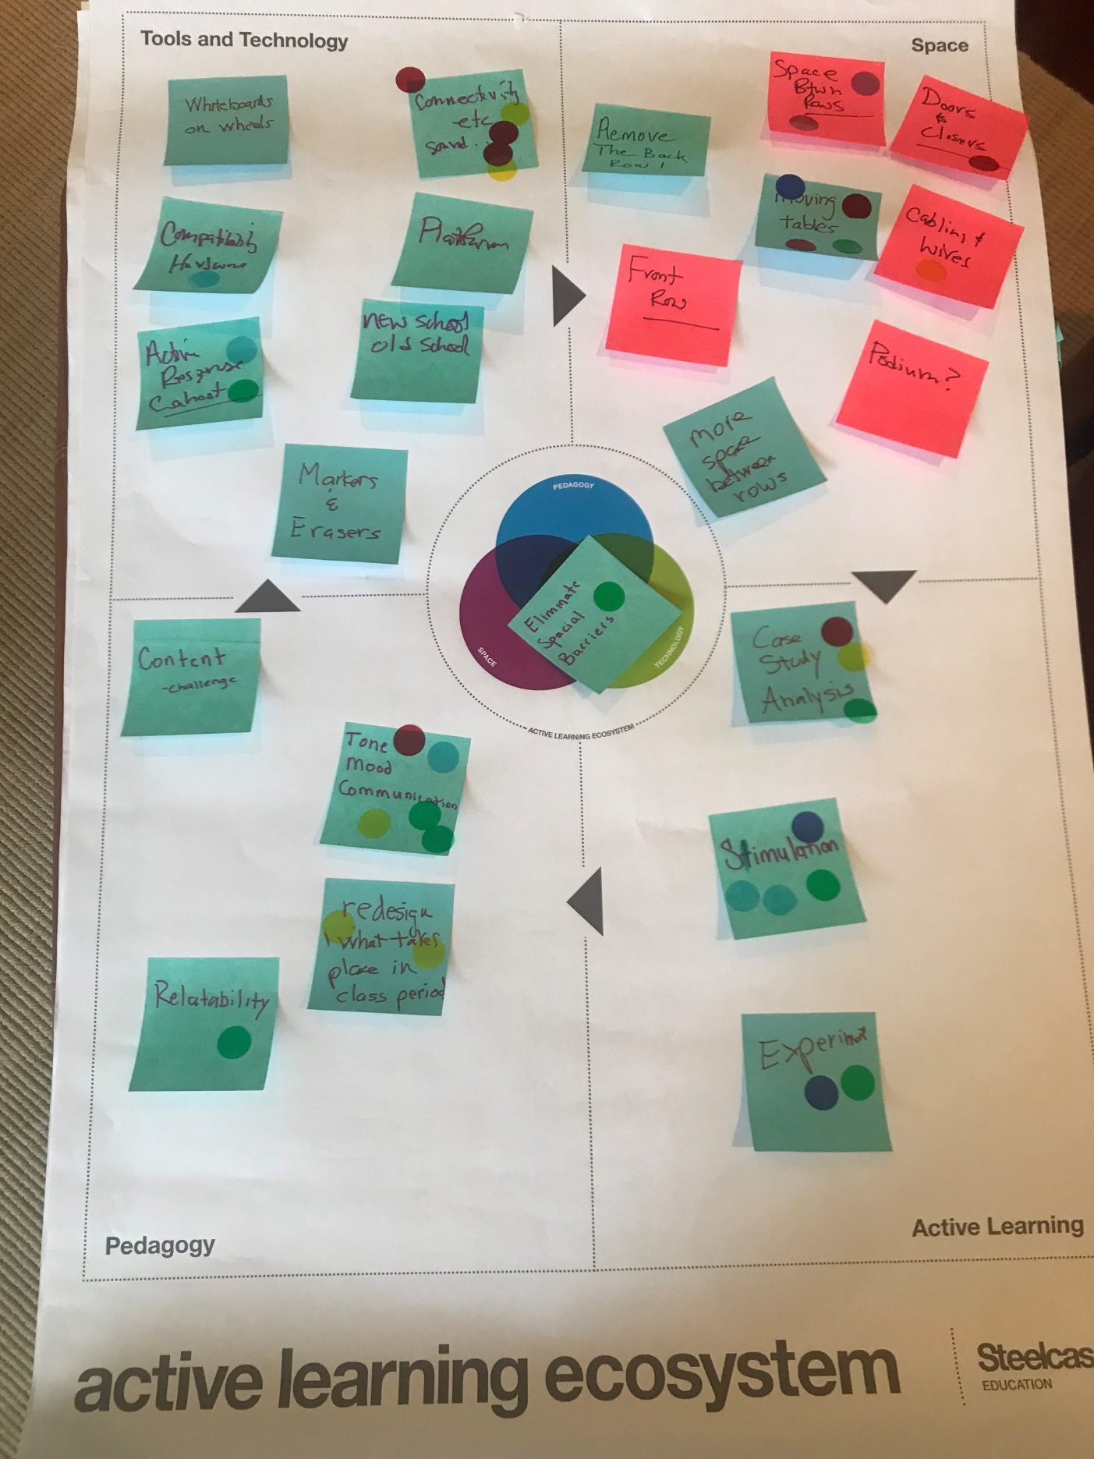
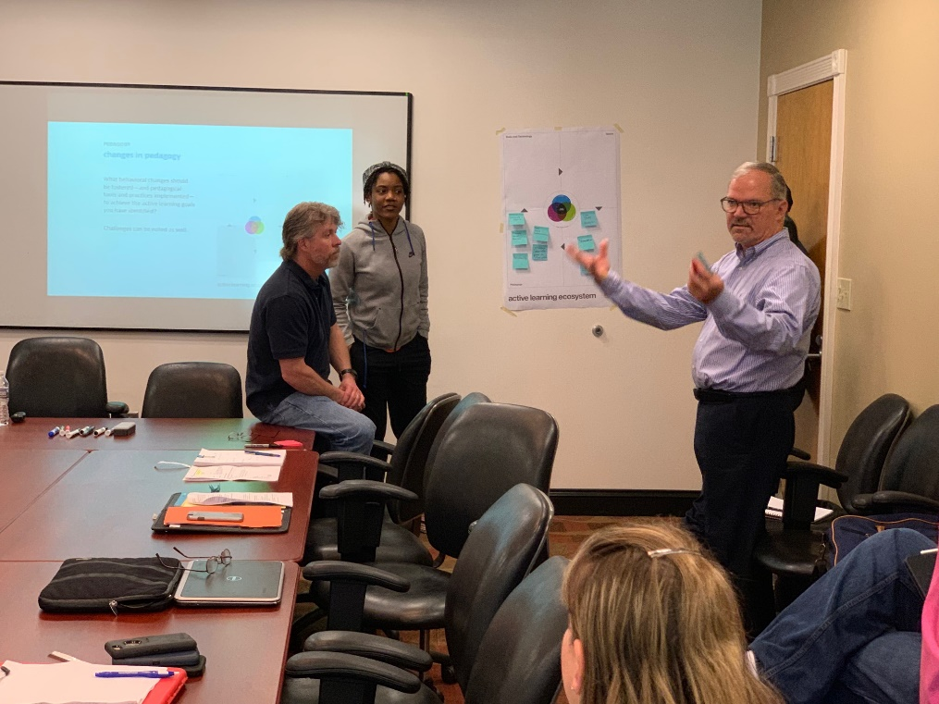

Slide 15
ACTIVE LEARNING Discussion :
Case study – sociology, psychology, business use different case studies and use them to teach
Simulate courtroom in government class to go over the curriculum
Experiments – economics – experiment to simulate real life
Problem solving skills – solve problems in class and use resources outside class too
Class participation – make sure everyone participating and awake
Less reading, more activities – too many books to read for some classes – how do you balance assignments and activities?
Community engaged learning – get everyone involved
Learn anywhere anytime – all accessible
Internships to apply learnings
Think, pair, share – break down
Participate – fun points to participate – you will earn made up points but people want these points and will throw out points
More tutoring, closer to students – in dorms and in school buildings – ways to get help
Application real world learning

Slide 16
PEDAGOGY Discussion :
Add clickers for feedback
Learn how your students like to learn – provide students different strategies to learn
Team based learning for a semester to reinforce learning
Relatable topics – make sure they know other things outside of the class – like know about different authors out there
Culture based learning – different cultures into learning to appreciate more
Active listening – listen and understand it – focus on what the teacher is saying, teacher to not focus on getting through agenda and more so on listening
No chalk and talk – just lecturing
Challenge of content – how can we get what they need to learn before get more active
Teachers should come out and physically be active in the space
No podiums or whiteboards being blocked by projection screen
Relatability – so can put in real life

Slide 17
TECHNOLOGY Discussion :
More outlets
Tablets easier to scribe on
Wifi in classrooms – technology is taking over
Have textbooks on time – have analog and turn it digital
Whiteboards on wheels and appropriate markers/erasers
Connectivity – Bluetooth access or cable connectors appropriate
Mac or PC – platform compatibility
Old school/new – dvd players don’t work, downloadable books
More computer labs around campus and the library is not 24 hours (people lose chargers or get virus)
More quiz and activity prep – people don’t know how to study on their own – teacher should go over things
Mics in the classrooms because they don’t talk loud enough
Use of smartphones – use apps on phone to interact like with polling or make chemical model in augmented reality – organization/planning – my101 to keep yourself accountable – app that tells you things to do
Put all apps in phone so can interact through it – Classmate has made an app that did multiple tasks in one (have textbook, etc.)…not actually developed by that person – Edmoto app

Slide 18
SPACE Discussion :
Color scheme that sets positive mood – fun colors
Desk and chairs that make the class flow
Various writing surfaces- like a tabletop and painted walls
Modular walls
Build smart classrooms
Distance and local students interact
Cannot write on classroom boards because black and put in work order
Erase classroom borders – People work in cafes in laptop and not distracting to have other activity around – learning happens everywhere
Students not having enough seats
Flexible and movable
Different departments work differently – need to design spaces for the different learning pathways
Right size room for the right class – 5-8 students in a lecture hall
More space between rows so teachers can interact
Move the back row and front row – back row not engaged
Doors and closures – teacher at the front and student late and has to walk past the teacher…awkward
Cabinets and wires and podium – podium/teacher is in the corner …go wireless so they can interact better

Slide 19
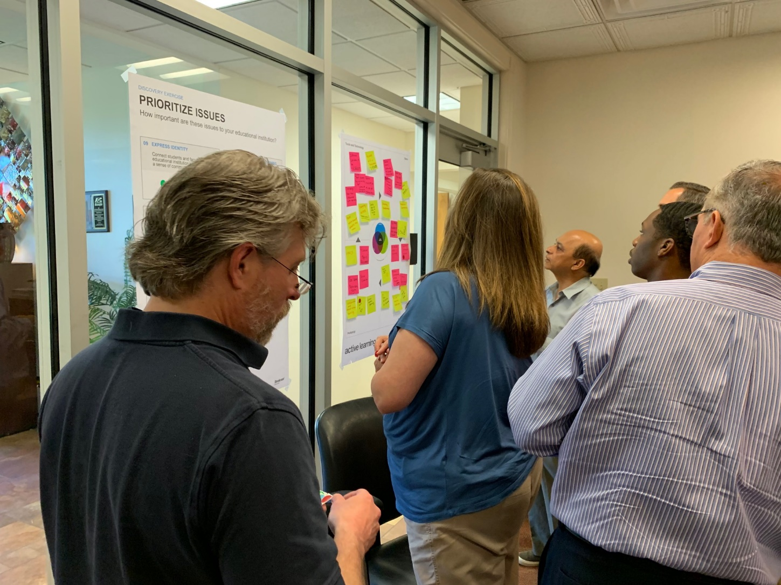
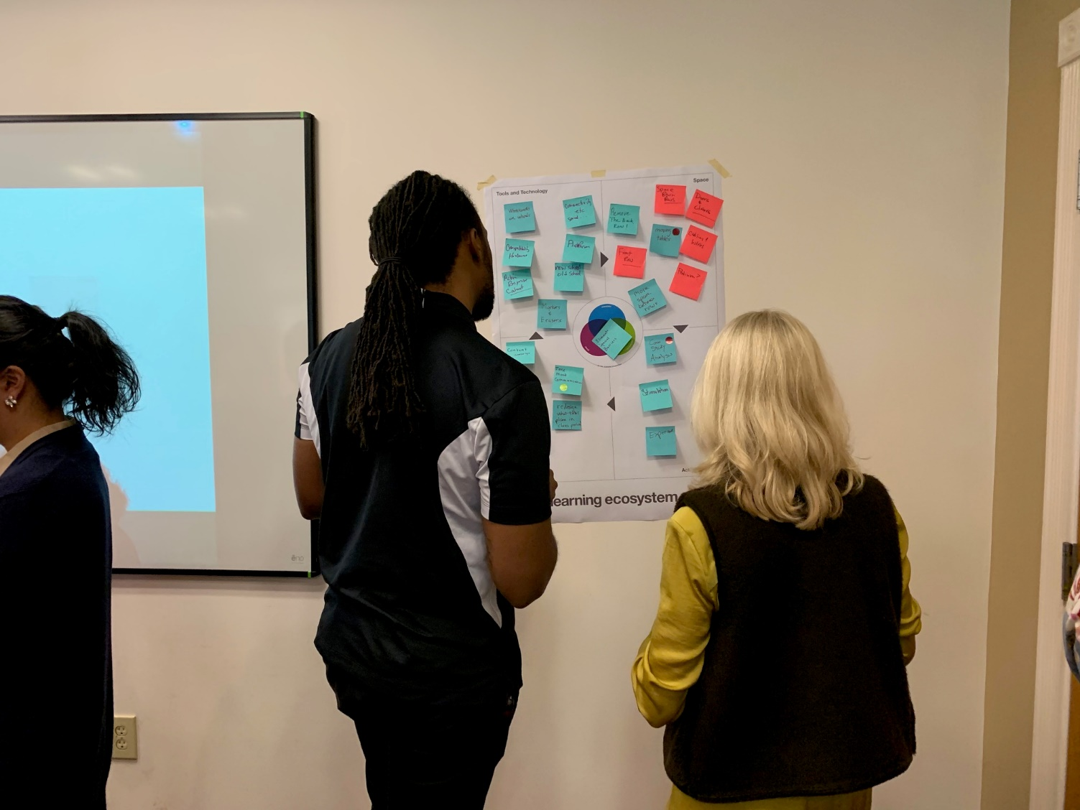
Multi-voting

Slide 20
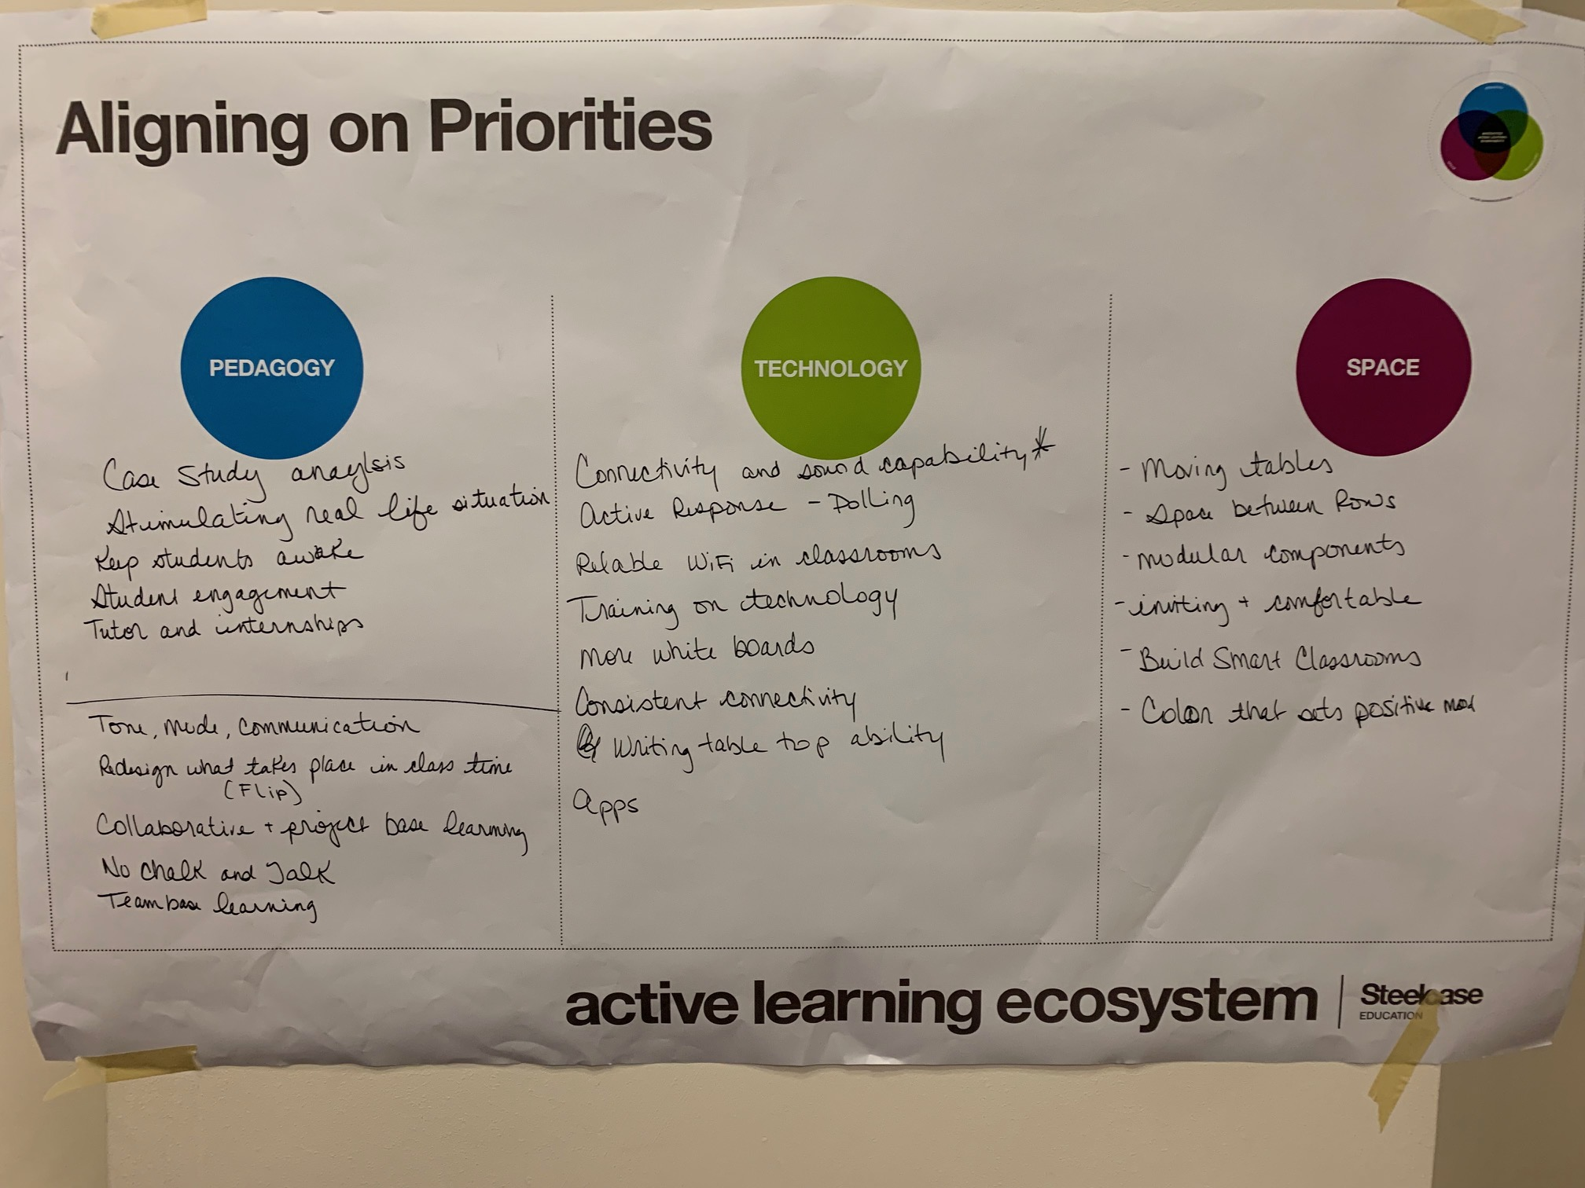

Slide 21
space impacts behavior…
Notes:
As a student, as a teacher, as a superintendent, as a college president, leverage space as a tool to improve learning and student success…

Slide 22
…and new behaviors are needed to support better learning
Notes:
As a student, as a teacher, as a superintendent, as a college president, leverage space as a tool to improve learning and student success…

Slide 23
how might you leverage your learning spaces as a strategic tool to improve student success?
Notes:
As a student, as a teacher, as a superintendent, as a college president, leverage space as a tool to improve learning and student success…

Slide 24

5/31/2019 Steelcase Inc.
©

