Slide 1
Fee Management Workshop

Slide 2
Overview
Program and course fee managers are responsible for the following
Quarterly reviews of fee accounts (budget office)
Annual review/Review and report of fee expenditures (Fee Committee)
If the fee was determined to be the type that requires BOR approval then an annual application for the fee must be submitted (Fee committee)
Role of fee committee
To simply make recommendations
Final decisions are made by the provost’s office and president

Slide 3
From BOR Manual
Any elective fee or special charge that is required to be paid by all students in a specific degree program or in a specific course with the exception of laboratory fees and supplemental course material fees shall be approved by the BOR, but shall not require review by a student fee committee.
What are lab and supplemental course fees?
They “cover specific costs such as art materials, course packets/kits, museum admissions, travel to off-campus learning sites, safety equipment, software/videos, and special equipment (BOR Minutes)

Slide 4
Outline
Fee Reviews
How to prepare them
What the committee considers
Fee applications
How to prepare them
What the committee considers
BOR approval

Slide 5
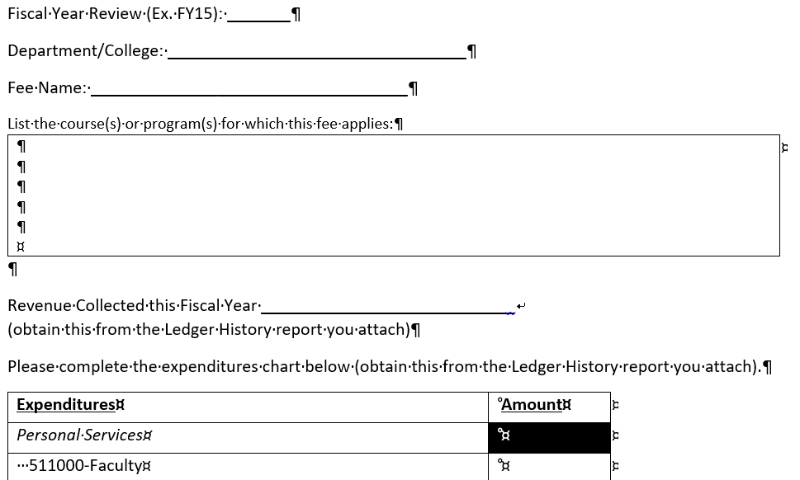
Fee Review Report Form C
Part 1
Pretty self explanatory

Slide 6
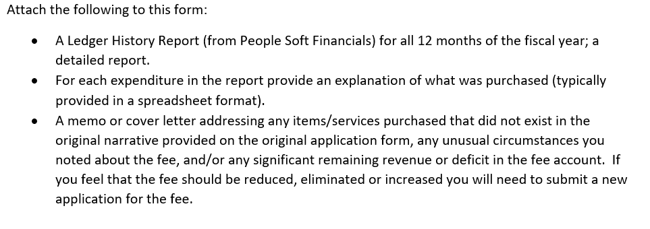
Fee Review Report Form C
Part 2

Slide 7
How to Run a Ledger History Report
Use this guide for instructions
https://clayton.edu/budget/docs/Ledger%20History%20Report%20Screenprints_PS%209.2.pdf
When running the report make sure to:
Check Detail Report and Summary Report
The Ledger is: Actuals
Run the correct FY and accounting periods should be 1 and 12.
Use your fee department code.
Accounting code should be 400000 to 999999
Fund 10600
Class %
Project %
Program 11100
See picture on next slide

Slide 8
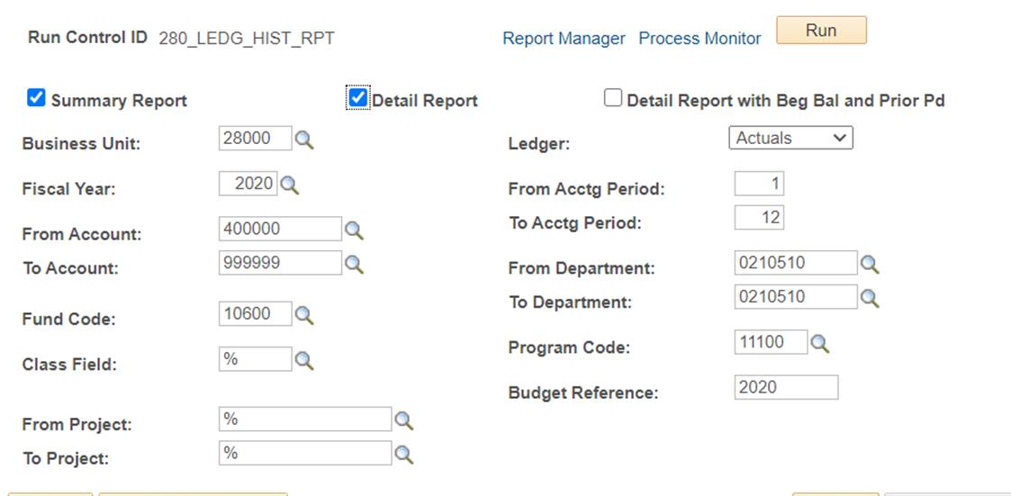

Slide 9
Ledger History Report
First look at the summary to give you an idea of revenue you had remaining or if you over spent.
Negative values represent revenue collected. So for example you should see revenue that came over from summer fiscal year cross over (40% of what you collected for the summer when the fiscal began; 60% remained in that previous FY), you should see Fall, Spring and Summer fee revenue listed out and you should see any other revenue collected (CARES Act funds for example during FY20).
Positive values are what you spent.
At the bottom you will see a total and if it is negative then you had funds remaining from the revenue you collected. If the value is positive then you spent more than the revenue collected.

Slide 10
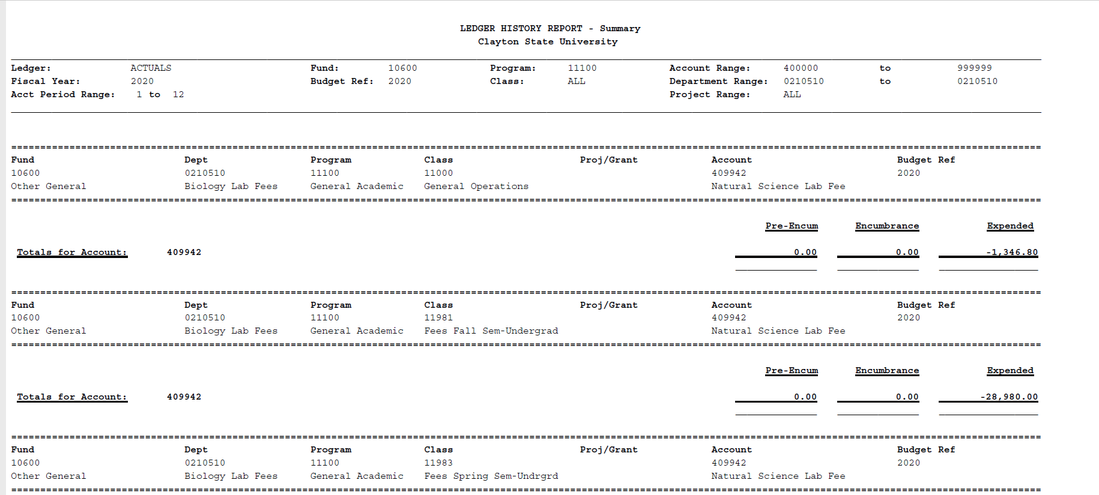
Samples-Negative=Revenue collected

Slide 11
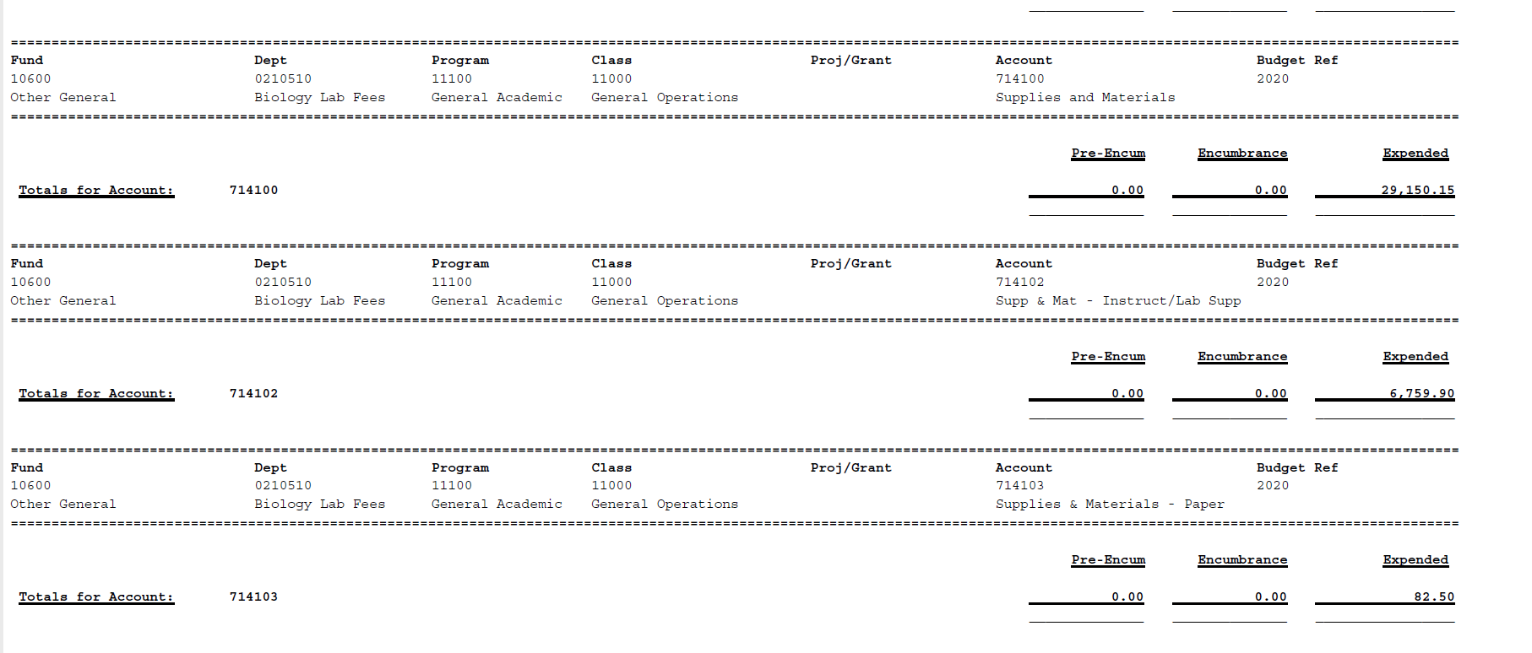
Samples-Positive =what you spent

Slide 12
Ledger History Report
Now look at detailed report.
On the detailed report you can view the Banner Journal entries which show the revenue collected daily. If you see a positive value that is a revenue reimbursement back to students.
In Spring 2020 you will see this if you fee was reimbursed to the students.
If this happened and you were given CARES funds to off set that loss in revenue then you will see this in “Transfers-Non_Mandatory” section of the report. But that was last year…

Slide 13
Ledger History Report
On the detailed report you can also view the expenditures like you viewed on your budget activity reports. It will show you some of the expenditure detail descriptions (Pcard, Epro, etc.) and vendors.
Use this to compare to your budget spreadsheets you should be keeping to manage your funds.

Slide 14
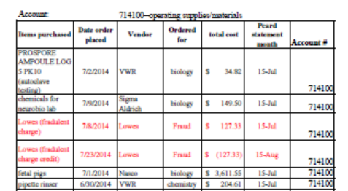
Another Sample Spreadsheet to Explain Purchases

Slide 15
Sample of wording from a sample memo

Slide 16
What the Committee Considers
When you don’t spend your fees this is bad and the committee may suggest to reduce or eliminate the fee.
Last year we noted several fees that had greater than 40% of their fee revenue remaining. We gave a gentle warning that if it happens again then we will reduce the fee this year.
Over spending fees is not good either. It happens sometimes as you have to monitor your revenue during the spring and guestimate how much fee money you will collect from summer registration.
The amount listed on your budget activity report for your fee budget is just an estimate by budget and finance. It is frequently not accurate. So make sure you run a revenue report when doing year end spending from fees account. This is accurate.

Slide 17
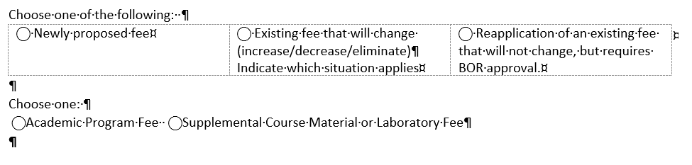
Fee Applications
When you need to do this?
You were informed if you have a fee that requires BOR approval and therefore requires you to reapply for your fee annually (highlighted in yellow on summary).
If you are proposing a new fee you also have to apply even if it doesn’t require BOR approval.
If you are changing (increase, decrease or eliminate) an existing fee.
Program versus course fee
Program fee typically charged once per year or once per semester for all students in the program (these require BOR approval annually)
Course fee is charged to students enrolled in a course (these typically only require BOR approval once).

Slide 18
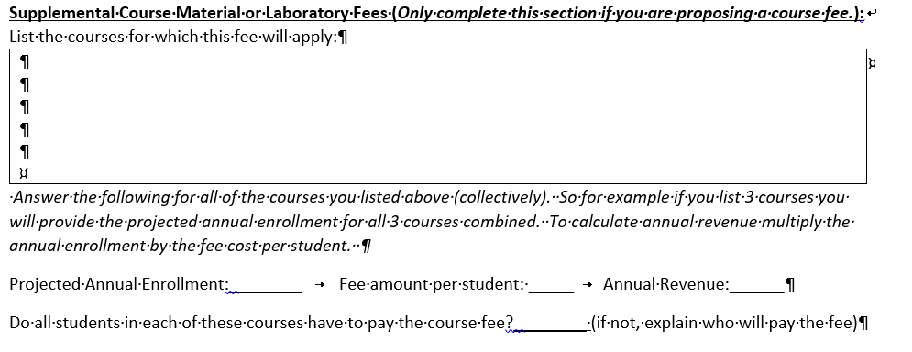
Fee Applications—course fee
If you do not know how to run the Metabase reports to get projected enrollment then contact institutional research. Giving unrealistic or “made up” values IS NOT in your best interest if you want the fee approved.

Slide 19
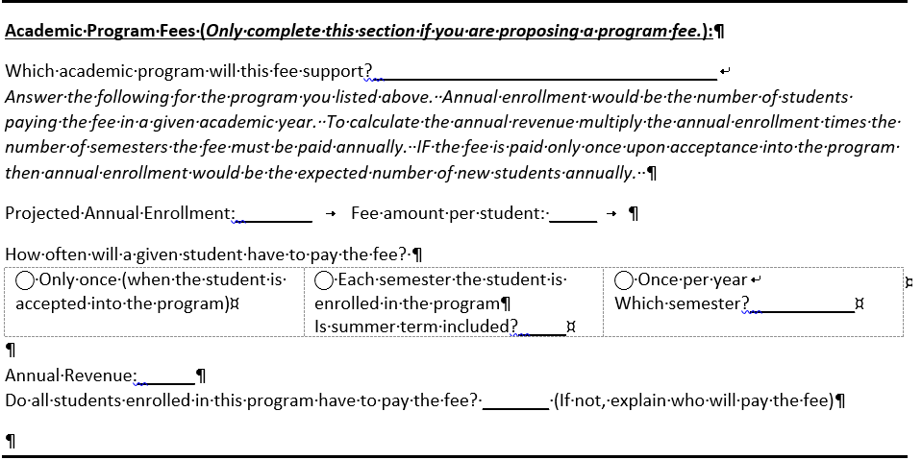
Fee Applications—Program fee
Annual Enrollment estimates can be obtained from Institutional Research
Annual revenue is annual enrollment multiplied by number of semesters students pay annually
If fee is paid only once upon acceptance into the program then you list expected number of NEW students and calculate the fee based on number of new students.
You must check which situation applies.

Slide 20
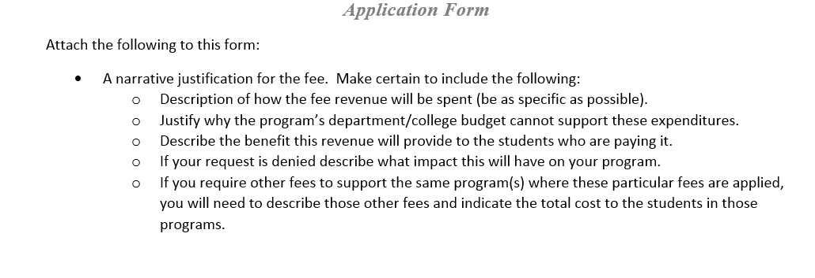
Narrative is Key

Slide 21
What the Committee Considers
Is there any other way we can defer these costs away from the student?
How would this fee benefit the student and is the benefit worth more than the expense?
Is the fee too high or too low for the proposed use? Can a typical student afford the fee?
Do other programs in the USG charge similar fees to the proposed fee?

Slide 22
Questions?
Send them to Mfurlong@clayton.edu

Slide 23
Review of Dates 2021
Oct.1: Fee Reviews and Fee Applications will be submitted to the Chair (Furlong)
Oct. 8: Fee Committee will meet from 12-2pm to review fee applications and Reviews
Oct. 15: Fee Committee recommendations on fees will be sent to provost and fee manager
Oct. 25: Appeals due (send to Furlong)
Oct. 29: Fee Committee will review appeal from 12-2.
Nov.3: Fee Committee recommendations on fee Reviews and new fees will be provided to provost and fee manager
If you are late then the committee will recommend not supporting your fee application or suspending your existing fee that is under review!

Slide 24
Attachments

